Slide 1
#CountOnMe
@GEMReport
Notes:
Welcome to the launch of the 2017/8 Global Education Monitoring Report.
[Introduce yourself.]
Throughout this event, if you want to take part in discussions and share online, please do so using the hashtag #CountOnMe, and @GEMReport.

Slide 2
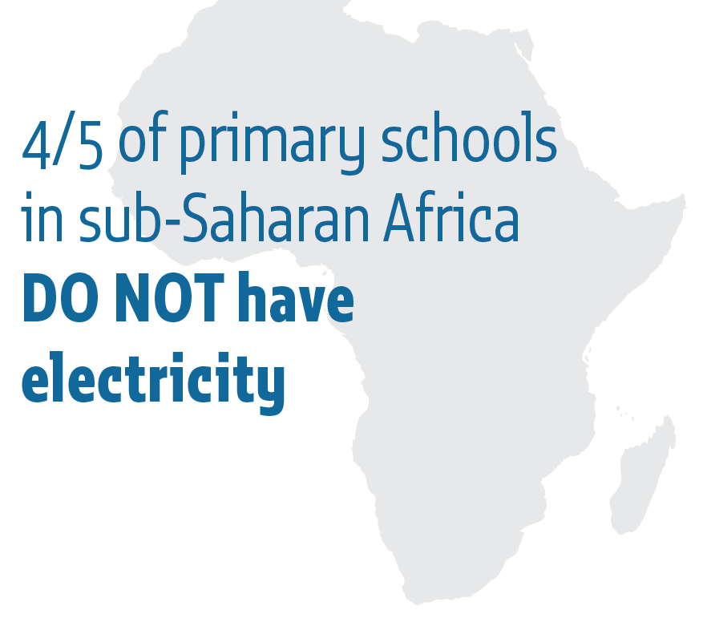
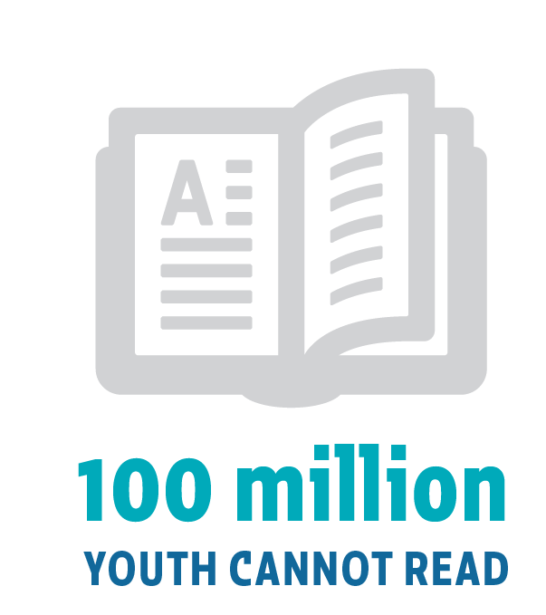
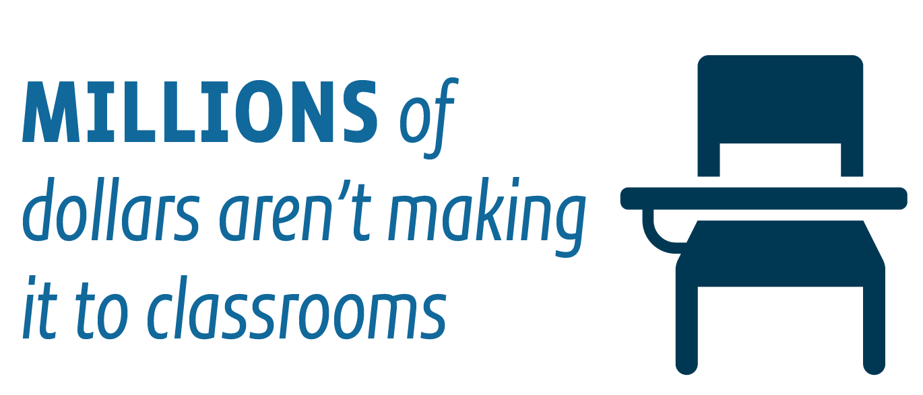
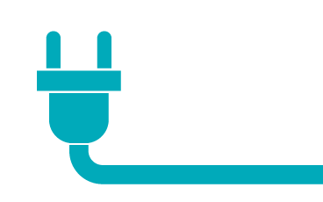
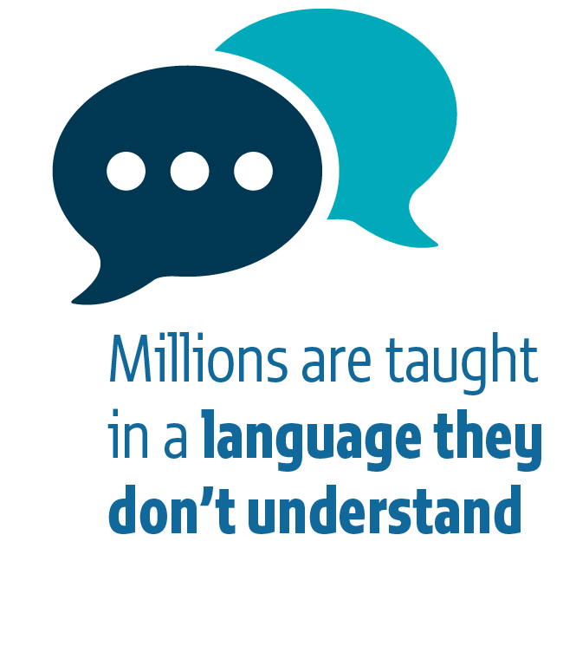
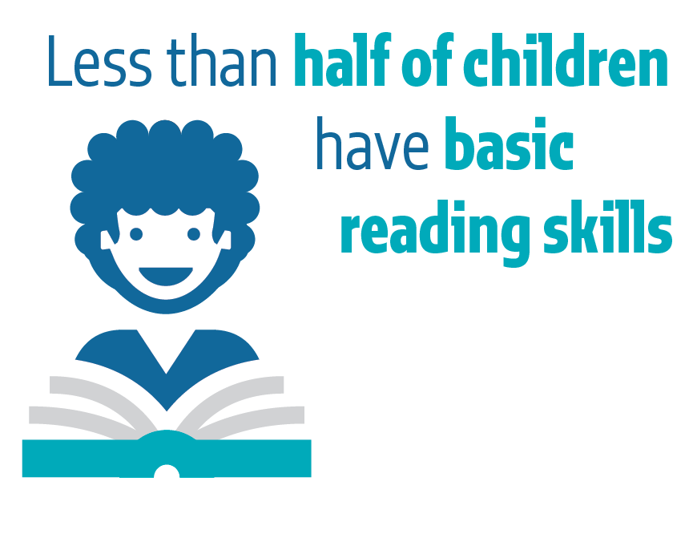
Notes:
Countries agreed on the sustainable development agenda two years ago, including the global education goal, SDG 4. The GEM Report was given a mandate by the international education community in 2015 to monitor progress towards education in the SDGs.
The second in our Report series shows that, despite strong progress, there are significant challenges remaining:
- Only 1 in 10 children in sub-Saharan Africa has basic reading skills.
- Around 100 million young people cannot read.
- Four-fifths of the world’s countries have not made pre-primary education compulsory.
- One in six primary school teachers are not trained.
- Resources are stagnating. Those that are spent often do not make it to classrooms due to leakage and corruption.
Accountability can help achieve progress against these challenges.

Slide 3
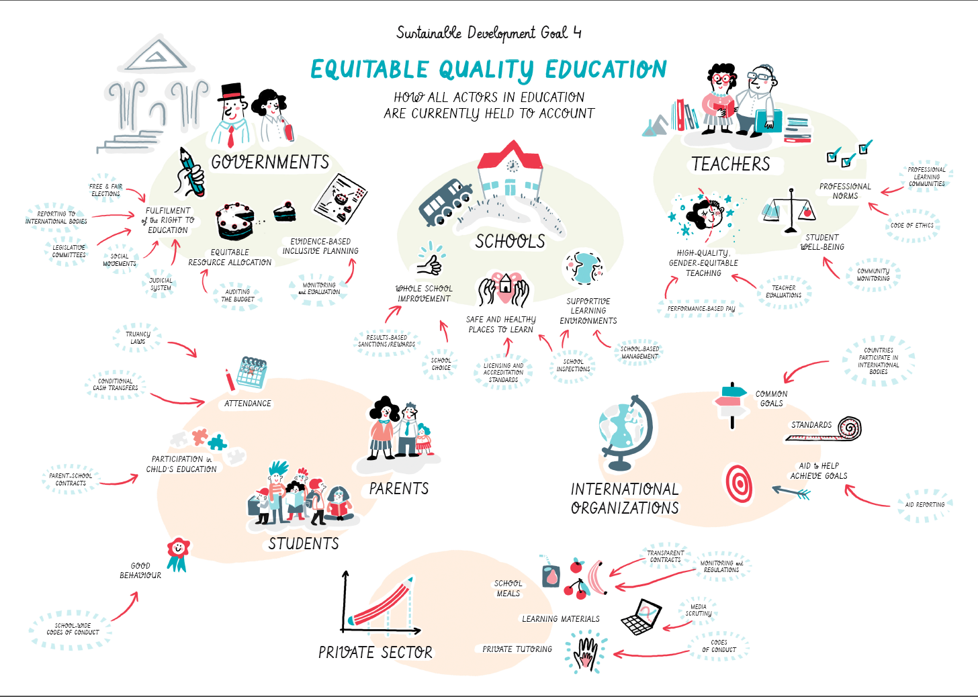
Notes:
Multiple approaches are taken around the world to hold different actors to account, as you saw in the video
A greater emphasis on accountability in recent years has spread from business to government and from other sectors to education, where it is fueled further by the following trends:
- Rapid expansion of education systems, which calls for tighter management and adherence to rules
- Decentralisation, which increases local control but calls on central government to maintain responsibility for monitoring and regulation
- Dissatisfaction with public education, which in some countries has called giving the chance for parents to choose schools and an education ‘market’ to be created
- Increasing availability of information, which encourages citizens to demand more transparency

Slide 4
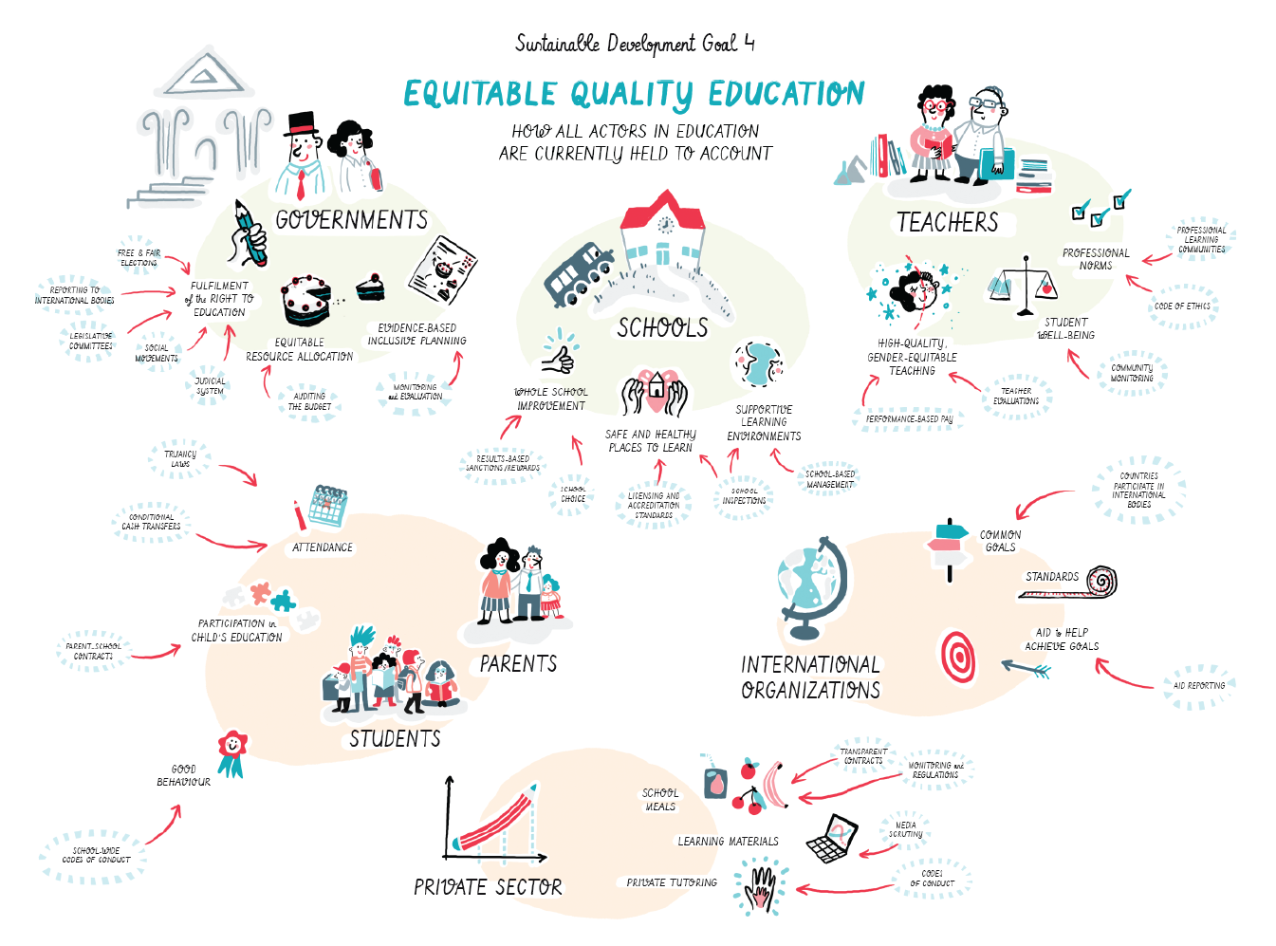
Notes:
You may be wondering what accountability actually means. We believe that accountability in education can help show who is responsible for what and how problems can be fixed.
A few truths must be shared from the outset about effective accountability, however:
- Ambitious education outcomes, such as those in SDG 4, rely on multiple actors from governments right down to students fulfilling often shared responsibilities.
- But while responsibilities are shared, accountability is not: it is connected to single actors, who are held to account for their individual or institutional responsibilities.
- People should not be held accountable for outcomes beyond their control. Teachers cannot be solely blamed for low student test results, for instance, which rely upon multiple other factors.
- If accountability is to help achieve SDG 4, flexible approaches are needed. Accountability mechanisms may be effective in some contexts and for some aspects of education and detrimental in and for others.

Slide 5
Notes:
Accountability matters enormously for improving education systems, but accountability for accountability’s sake is misdirected. It should be understood as a means to an end – a tool in achieving SDG 4 targets – not as a goal of education systems in itself.

Slide 6
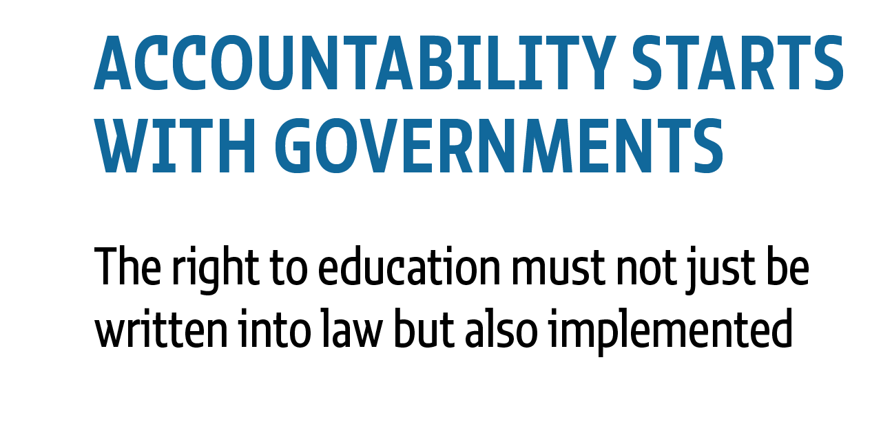
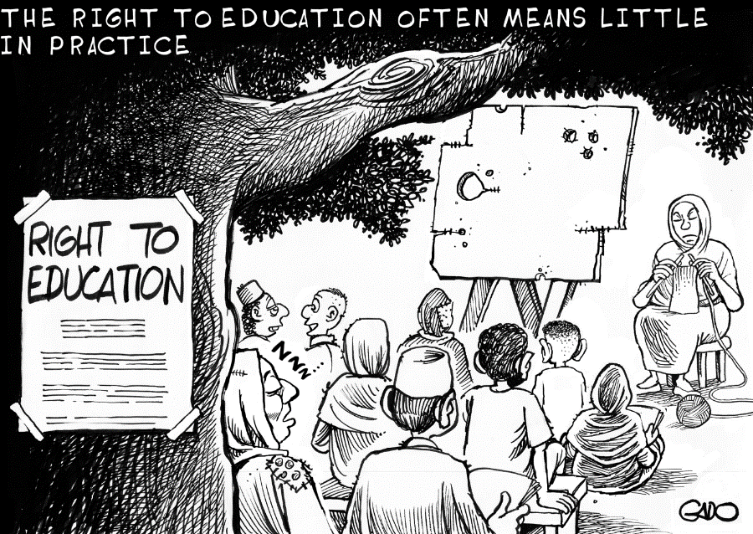
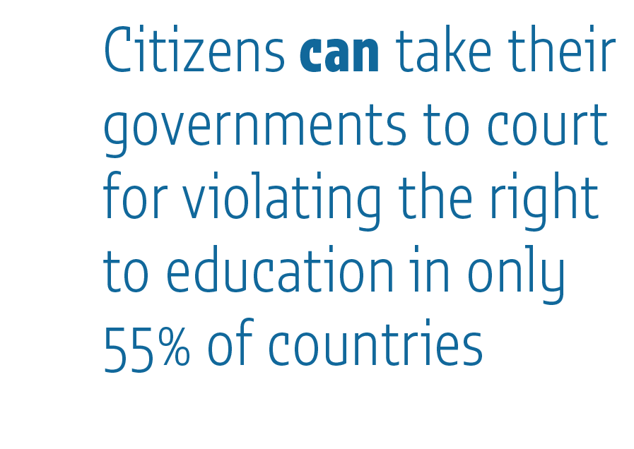
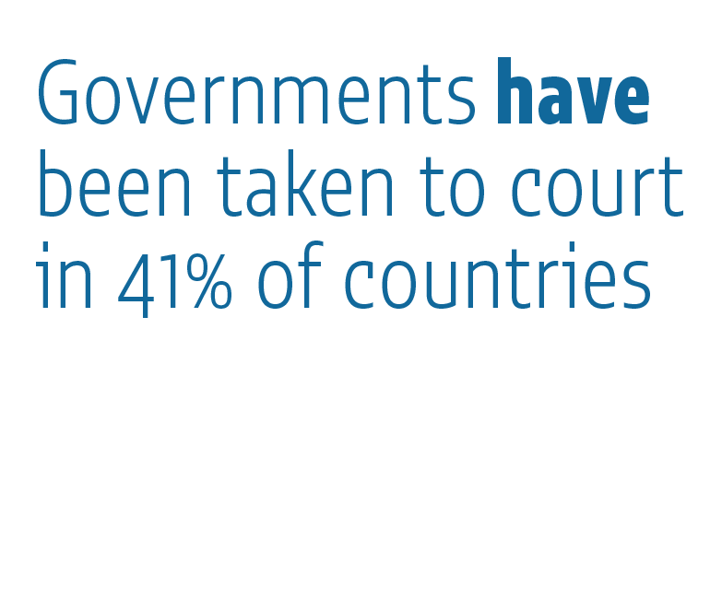
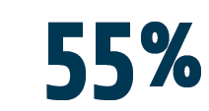
Notes:
While everybody has a responsibility in education, accountability starts with governments. For this reason, the majority of this power point will focus on recommendations for governments, although our full Report contains far more than that, with a whole chapter on teachers, one on schools, one on parents and students, one on private actors, and one on the international community.
Accountability starts with governments as they bare the primary duty to ensure the right to education. And it is not enough to simply put the right down in law; governments also need to implement it.
Every country in the world has ratified at least one international treaty illustrating this commitment. However, in only 55% of countries is the right to education justiciable, meaning that citizens can take governments to court for violations. And in even fewer countries has this opportunity been used.
Civil society organizations and the international community should lobby for the right to education to be made justiciable in national legal frameworks.

Slide 7
Notes:
This report lays out the following recommendations to help governments to design and implement robust accountability systems.

Slide 8
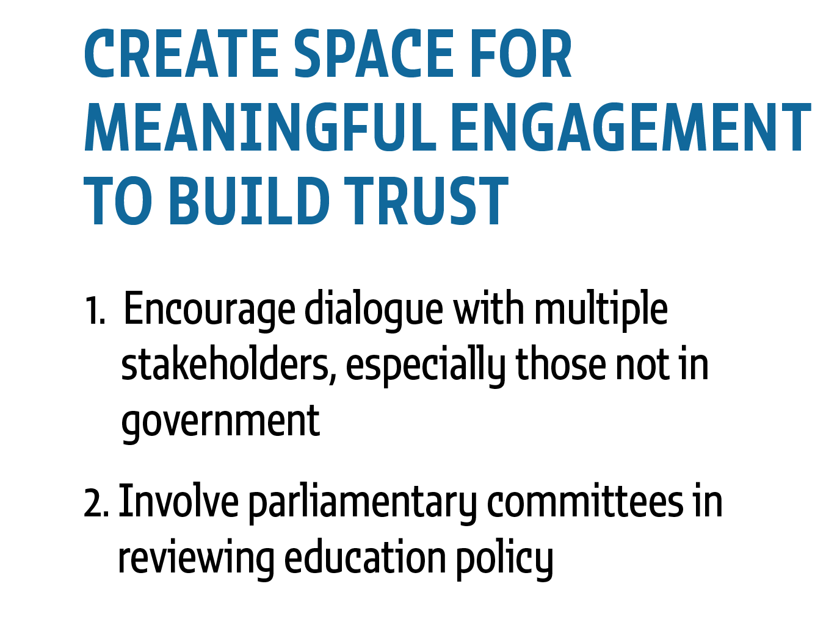
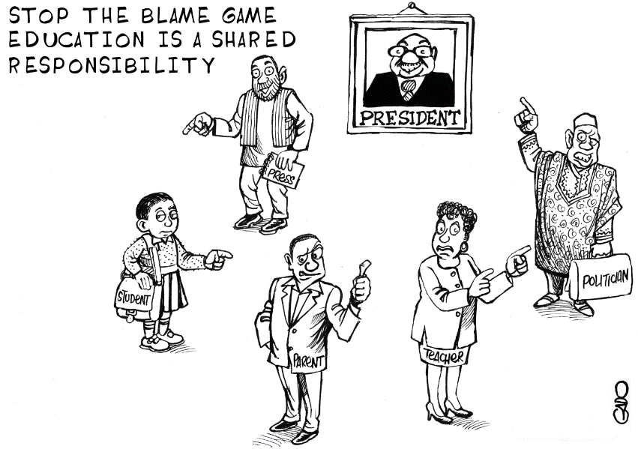
Notes:
Governments must create the space for regular meaningful engagement with all education actors to build trust and a shared understanding over their respective responsibilities. In Brazil, for example, over 3 million people participated in a consultation on the national education plan. But around the world over 60% of teacher unions were never or rarely consulted on the development of teaching materials.
Governments should strengthen the role of formal representative institutions such as parliaments by promoting their processes and building their capacity. In the United Kingdom, where this has happened, education policy changes are often identical or similar to the parliamentary education committee recommendations.

Slide 9
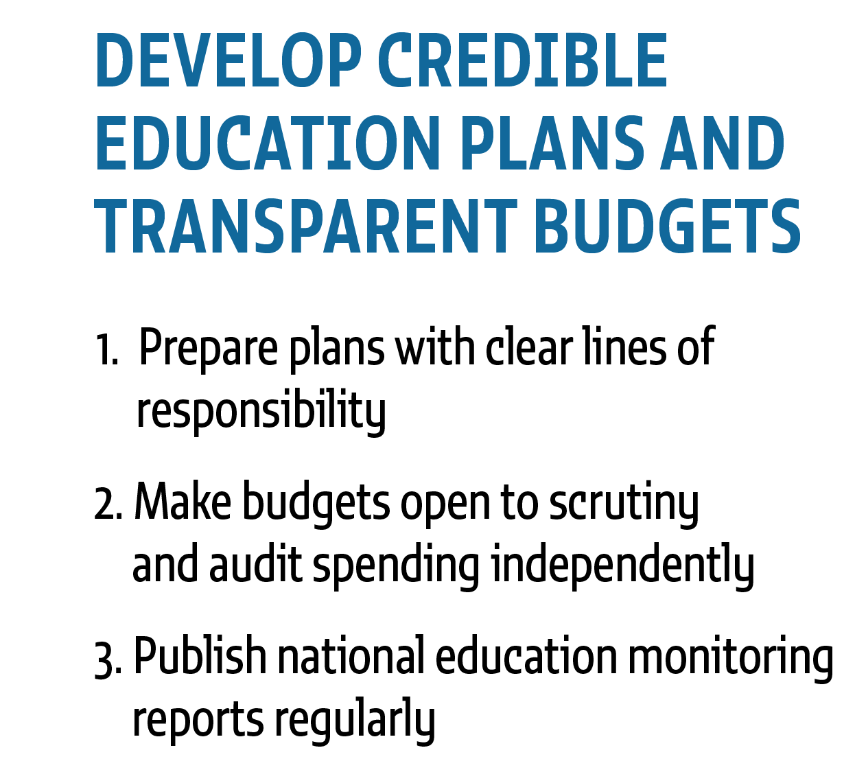
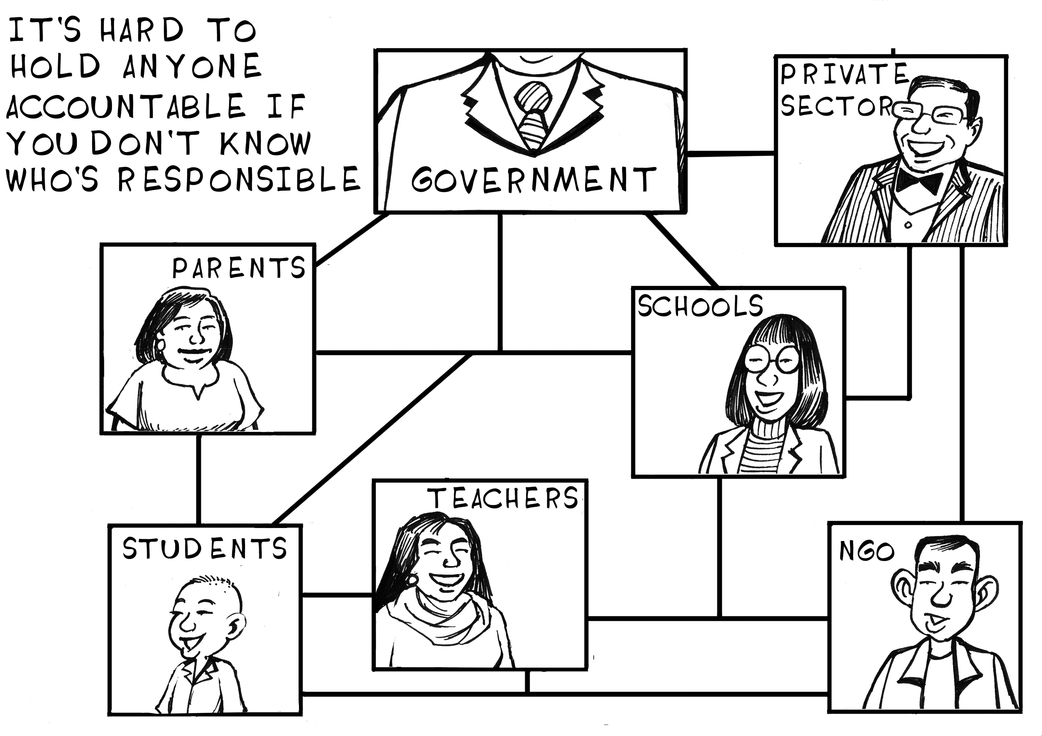
Notes:
A credible education plan with clear lines of responsibility is the basis for accountability. We cannot hold people accountable if we don’t know what they are responsible for.
In addition, resources to implement the plan should be allocated through transparent budgets that can be fully tracked. Where budgets are not sufficiently transparent or those who should scrutinize them do not have the skills to do so, the role of civil society has been important. In Chile and the Republic of Korea, for example, citizens make suggestions online for areas that need the auditor’s attention.
Finally, governments should produce a publicly available national monitoring report that covers all levels of education and analyzes progress against national education plans and budgets. Yet, since 2010, only one in two countries have produced a national monitoring report and only one in six have done so annually.

Slide 10
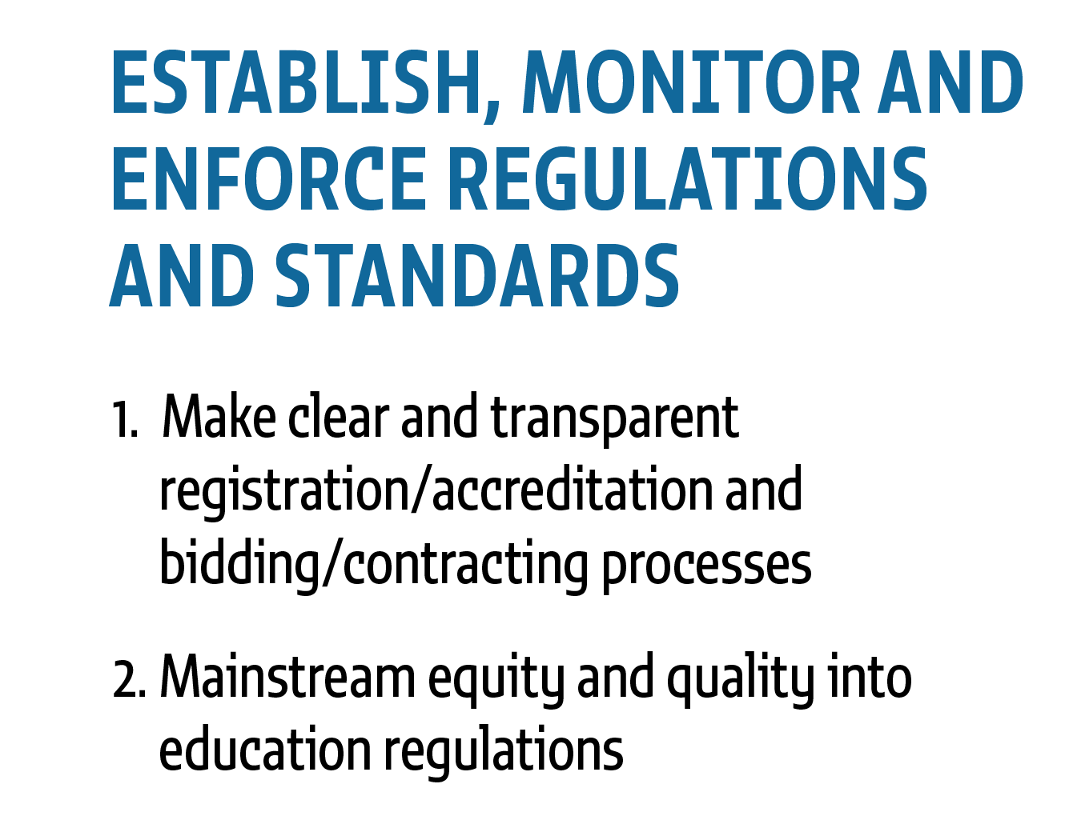
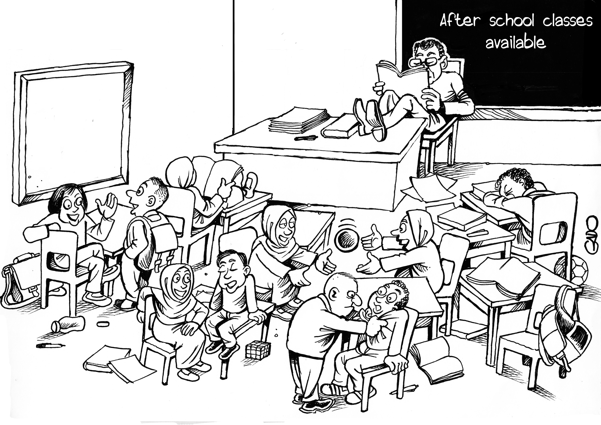
Notes:
Laws and regulations are the backbone of a well-functioning state.
- But these are often absent. For example, GEM Report research shows that in almost half of countries there are no regulations on class sizes .
- Likewise, regulations should be comprehensive, covering both public and private providers. Yet they often do not. In Lagos State, Nigeria, for instance, only a quarter of private schools had ben approved by the Ministry.
- Finally, regulations should not be short-sighted but should help drive equity and quality.
Regulations, notably those related to registration and accreditation, should be clear and transparent to facilitate monitoring and enforcement. Hong Kong has an online list of registered private tutoring centres and prosecutes those un-registered, for instance.

Slide 11
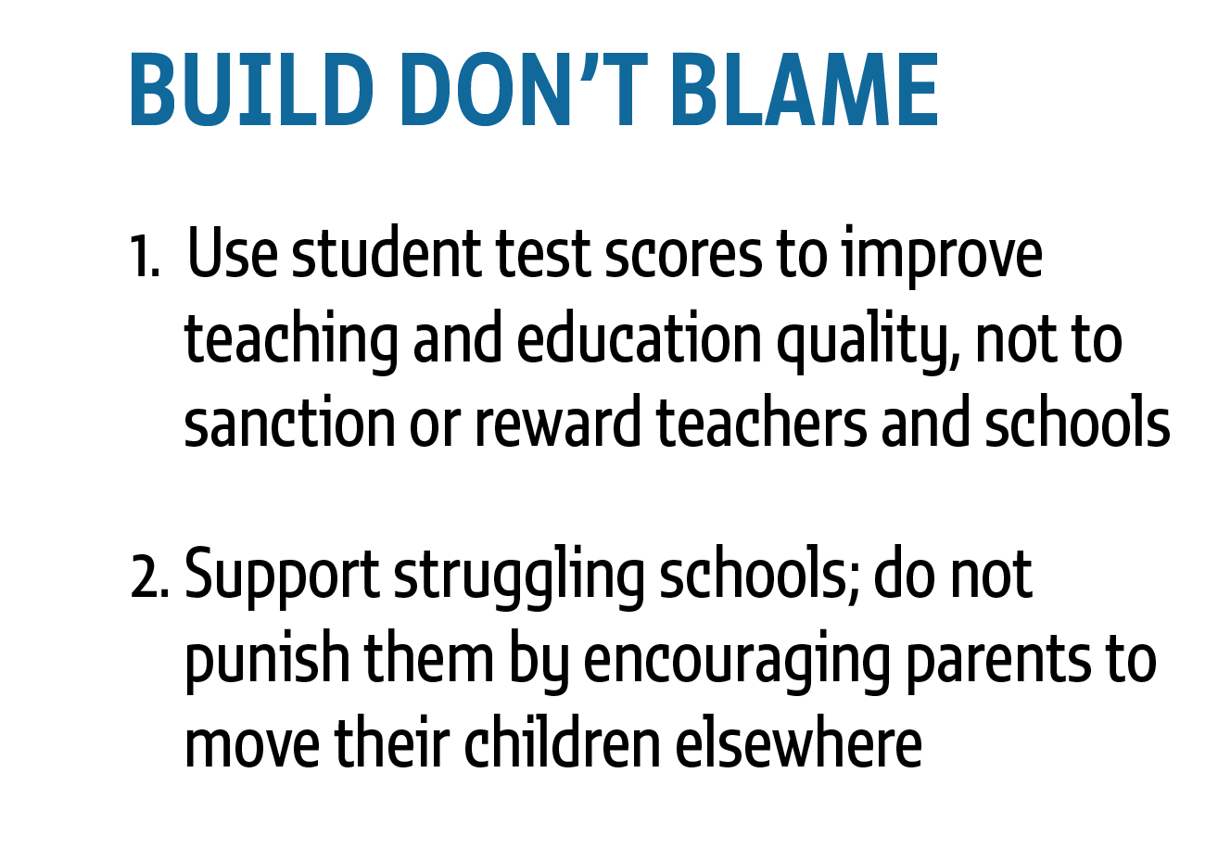
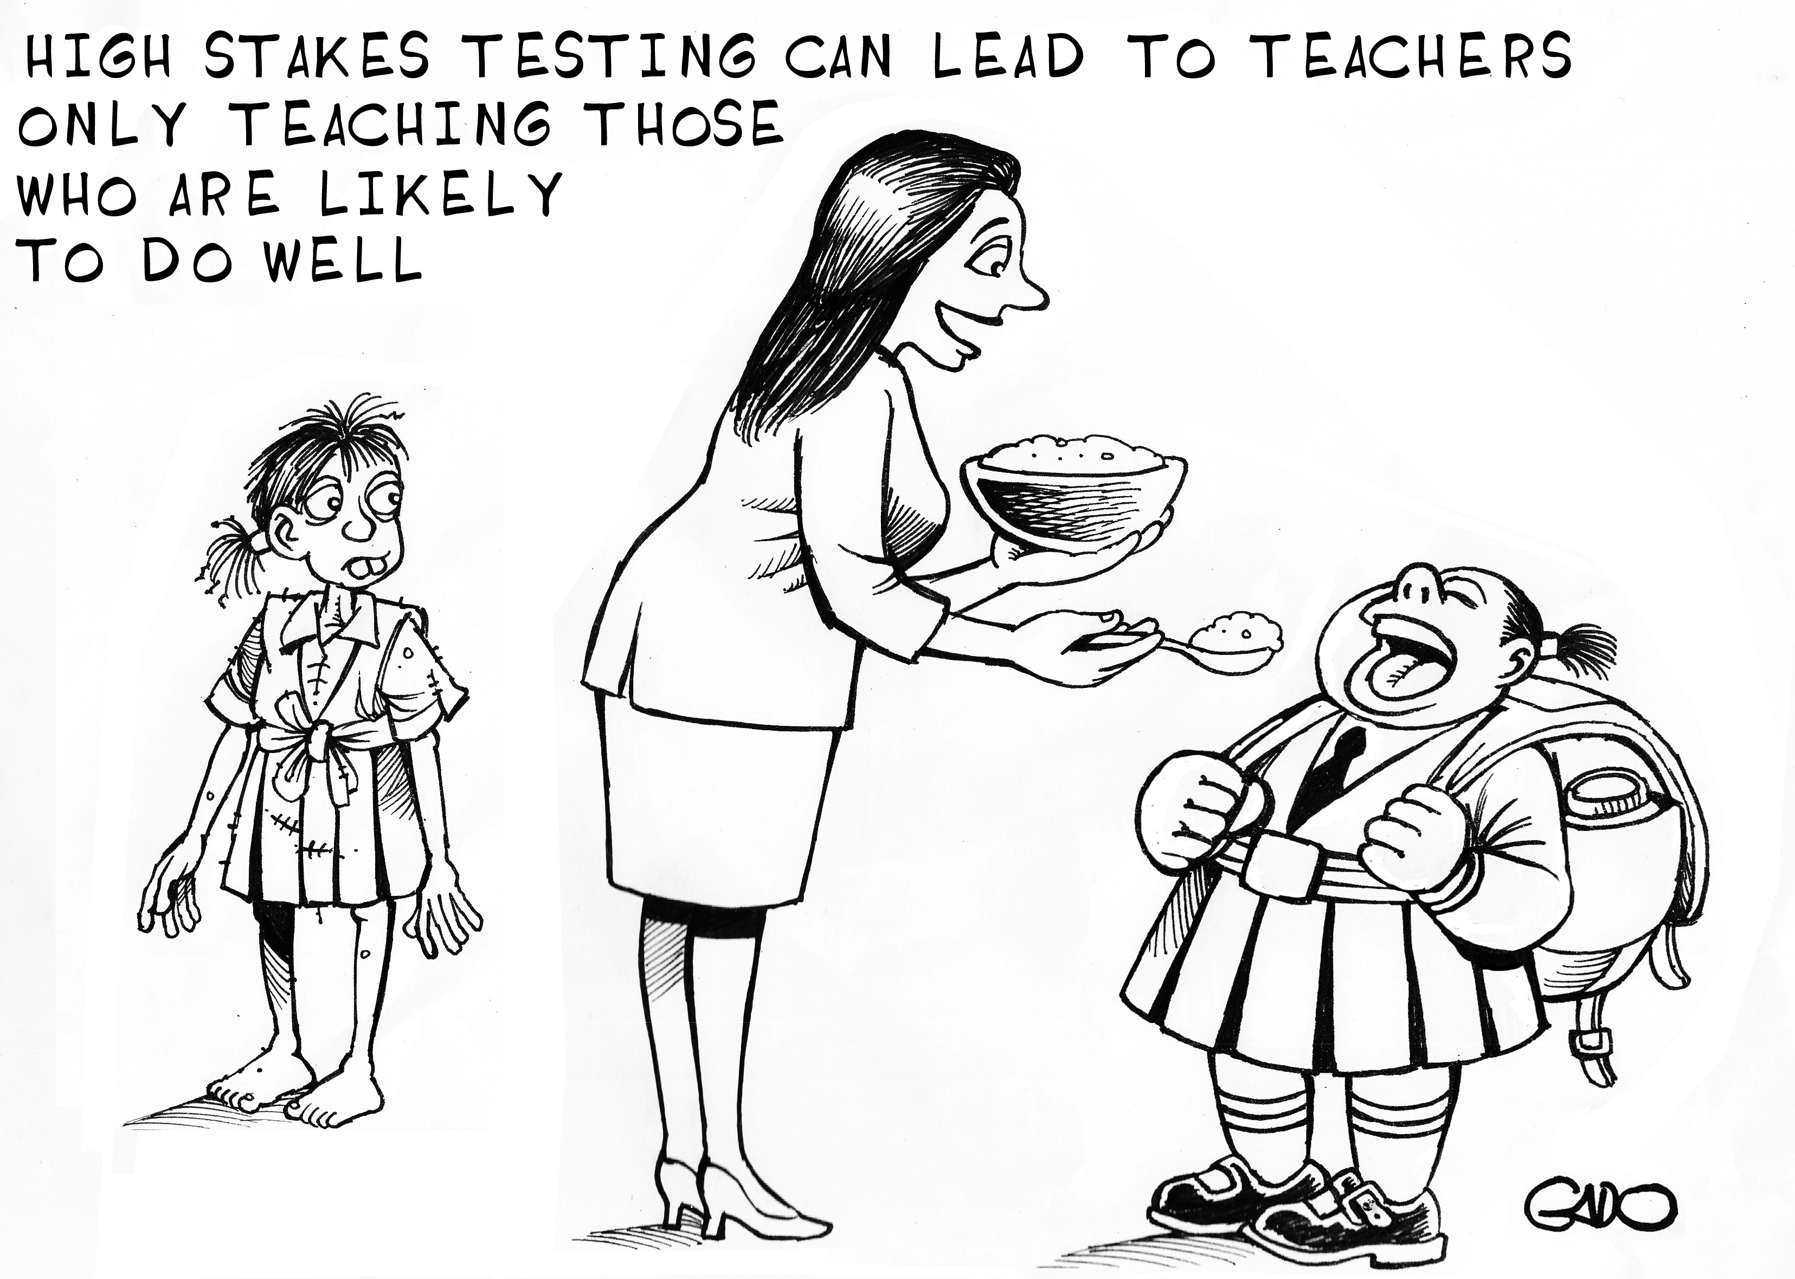
Notes:
There is a growing tendency, especially in high income but also increasingly in middle income countries, to use student test scores to sanction schools or teachers. But instead of improving learning outcomes, these can undermine education quality and learning.
Of 11 countries with such systems participating in PISA from 2003 to 2015, five saw some increase in learning, while 6 saw it fall. Governments should avoid punitive accountability for teachers and schools, especially those based on narrow performance measures. It promotes unhealthy competition, narrows the curriculum, encourages teaching to the test, demotivates teachers and disadvantages weaker students.
A somewhat similar approach is to promote market-based systems, which are supposed to motivate schools to counteract parental pressure to move their children elsewhere. However, school choice often leads to segregation. The competitive pressure marginalizes disadvantaged parents and schools. While targeted vouchers in some countries have helped overcome some of the constraints, in other cases schools simply increase their fees.

Slide 12
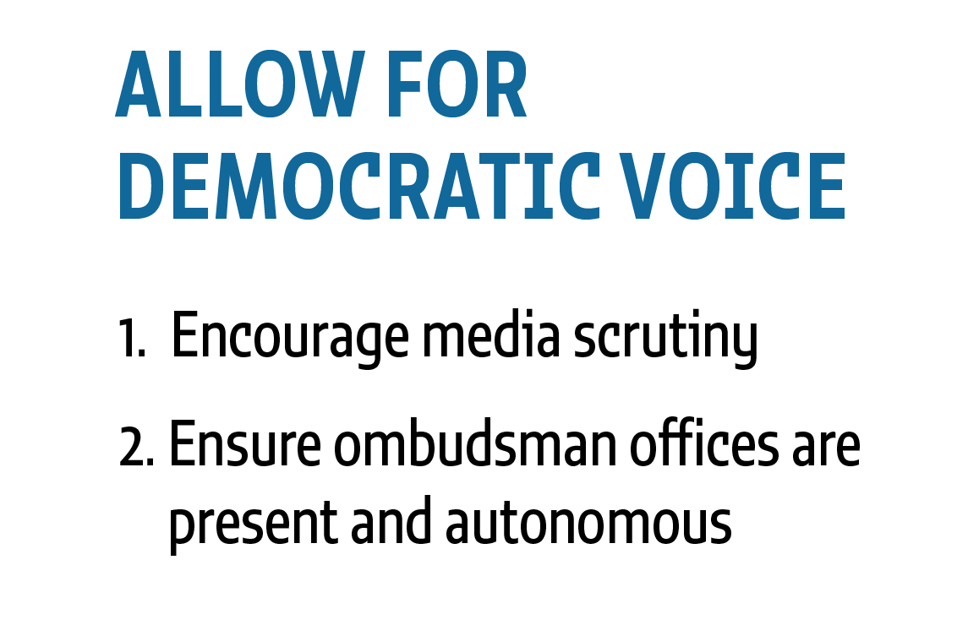
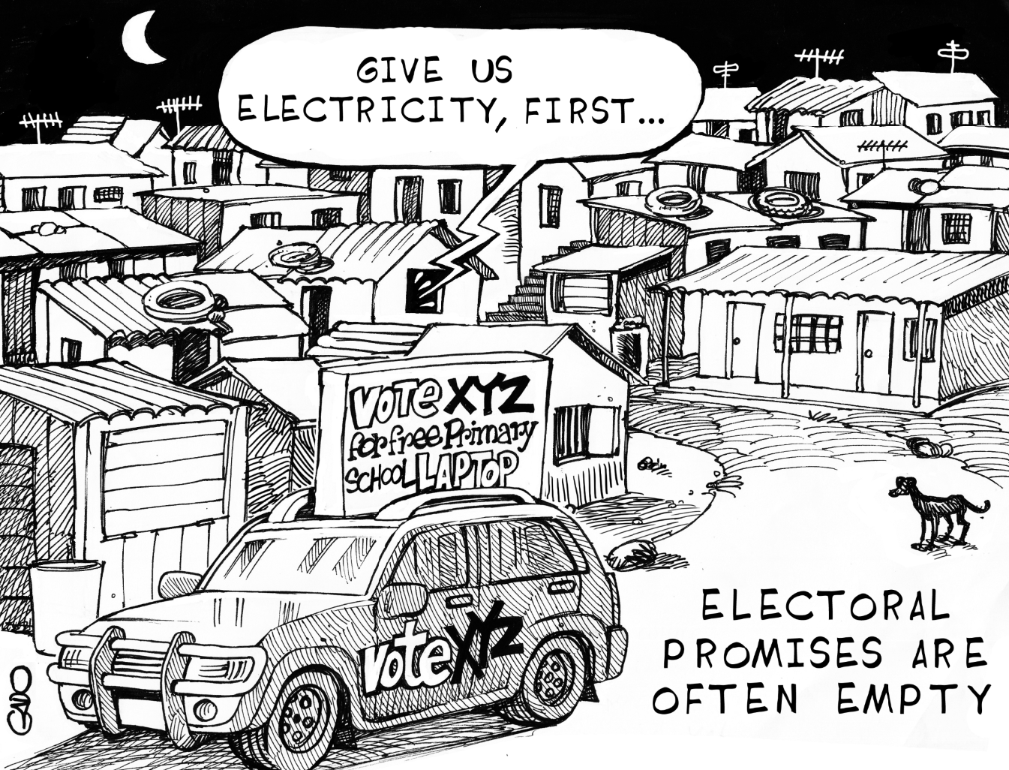
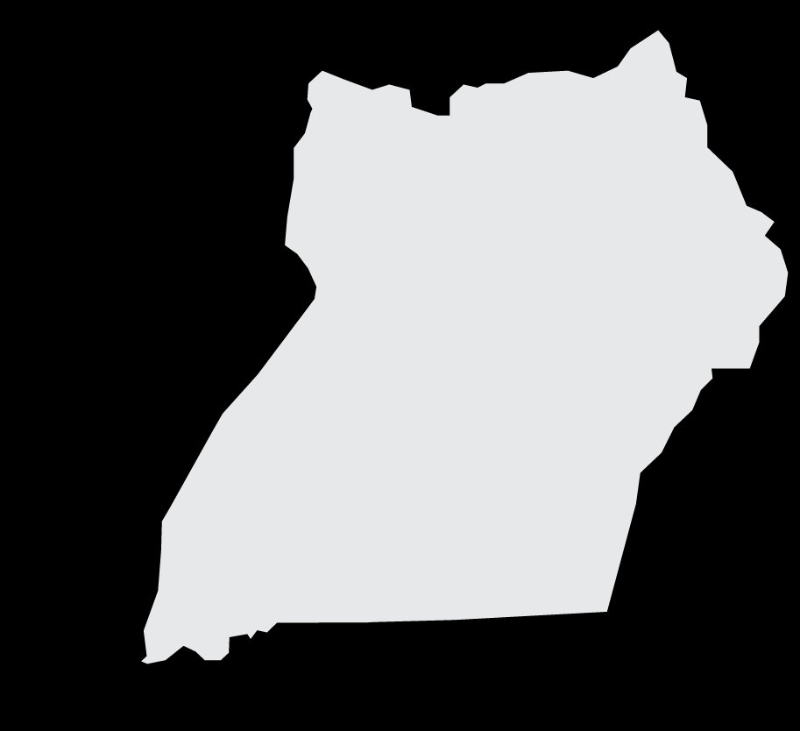
Notes:
Governments need to allow for a democratic voice, protect media freedom and set up independent institutions for citizens to voice complaints.
The media is a vital partner, helping put pressure on governments. They publish investigative stories that expose corruption or they channel interesting research results and analyses. They also provide information to people that have limited access to it. In Uganda, the government ran a newspaper campaign to publish information on grant disbursements down to school districts. As a result, schools that were closer to a newspaper outlet were more likely to receive school funding.
Ombudsmen, who have been influential in promoting the right to education, for example in Latin America, must also remain independent to be effective as channels for citizens to voice complaints.

Slide 13
Notes:
Regardless of design, if governments and other key stakeholders lack information, resources and capacity, accountability is hard to implement.

Slide 14
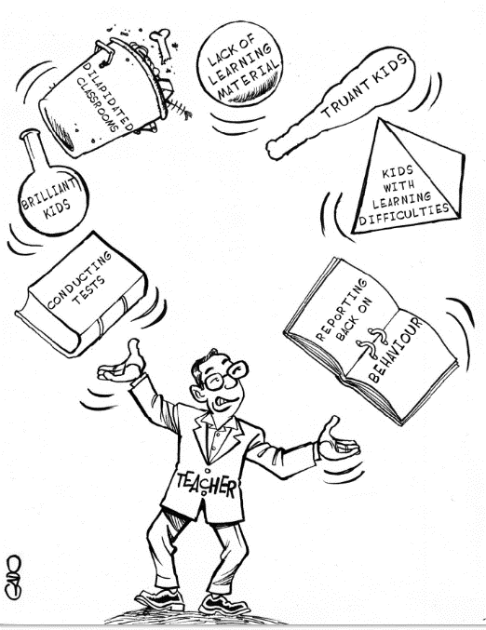
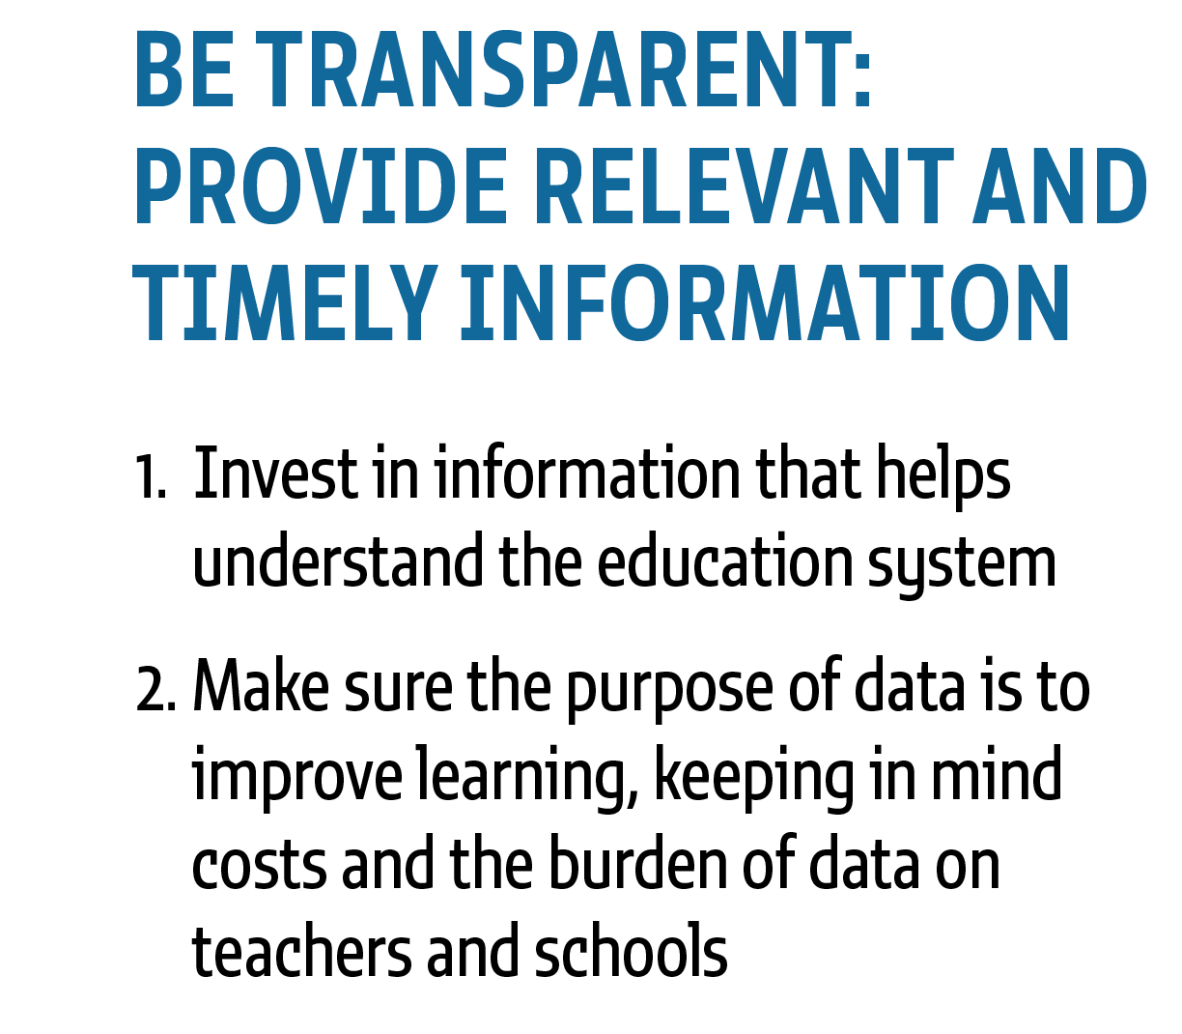
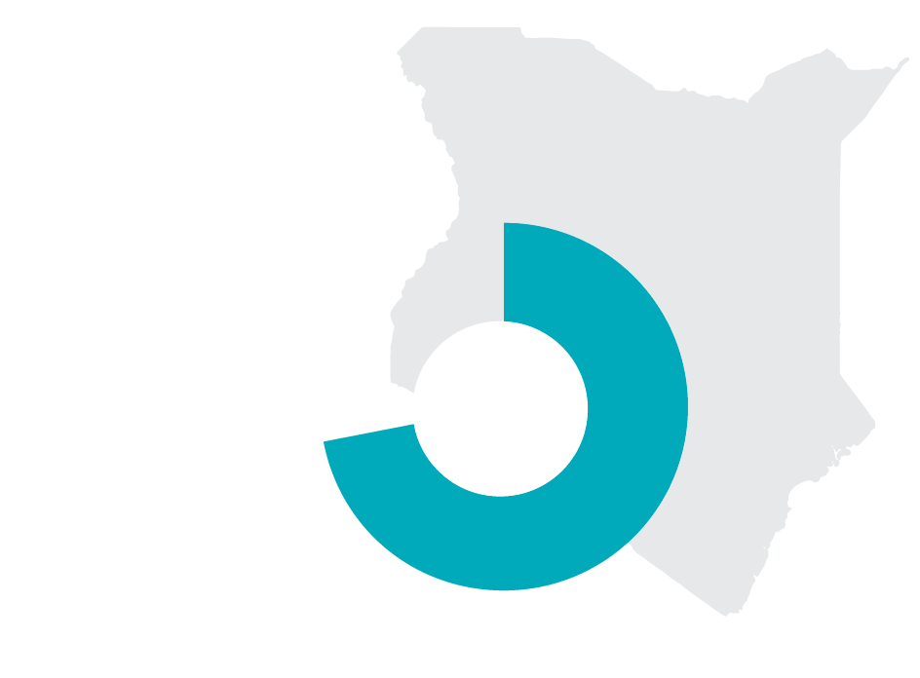
Notes:
Governments should invest in information but the kind of information that improves understanding of the education system’s strengths and weaknesses. In Kenya, for example, 72% of parents did not know what actions to take once they were provided with student learning data.
At the same time, we must be judicious in the data we select to collect and the use we make if it. All data collected should be tailored to its intended use and the cost of collection should match the capacity of the country to process it. Even in a rich country such as England, 56% of teachers argued increased data collection created more unnecessary work. Reporting tasks for teachers and principals should not be merely procedural but must be linked to improved teaching.

Slide 15
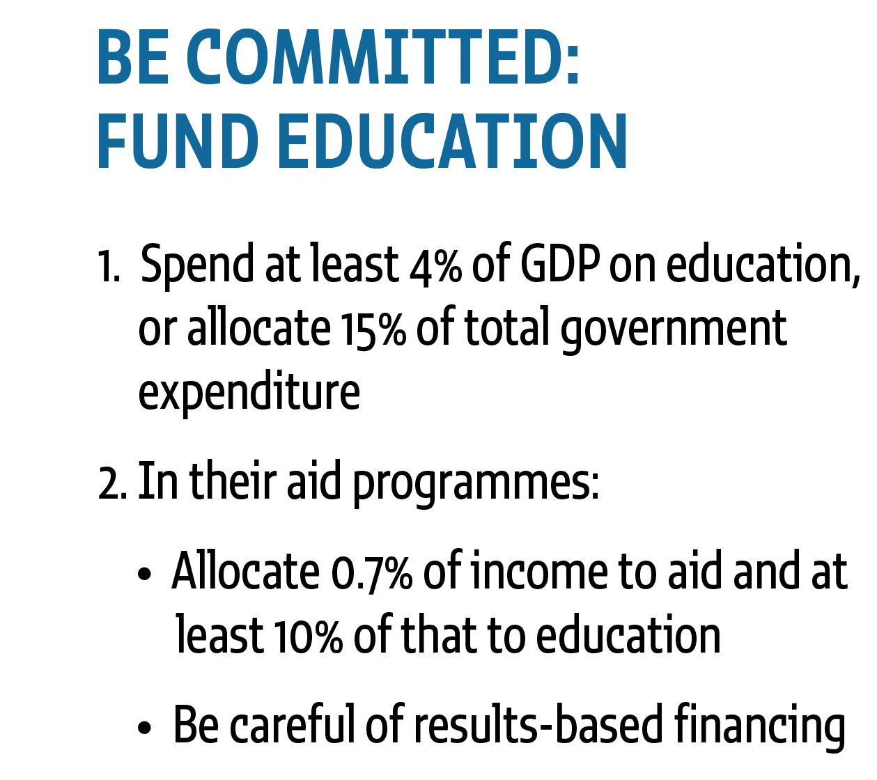
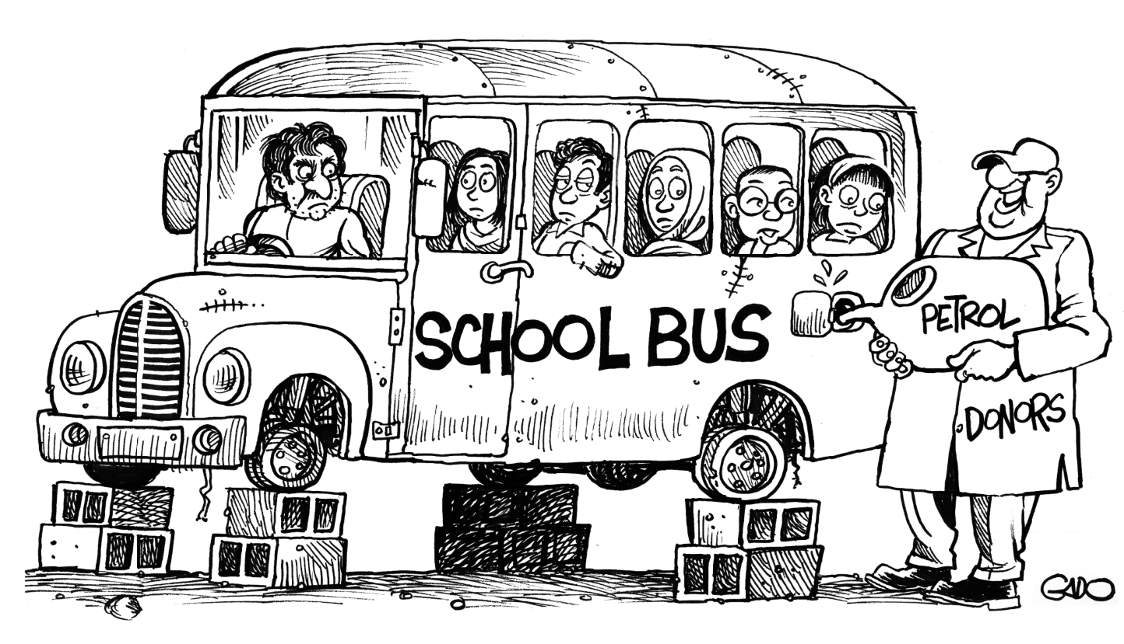
Notes:
Adequate finances should be provided to fund the education system. Governments should spend at least 4% of GDP on education, or allocate 15% of total government expenditure. But, as we heard earlier, one in four countries did not reach these benchmarks.
Donors should keep to their commitment to allocate 0.7% of GNI. Preferably they should allocate 10% of that to primary and secondary education. But, as we now know, the share of aid to education has fallen for six years in a row.
Not only that but donors increasingly allocate this aid through results-based financing mechanisms. As with the criticism of introducing sanctions for results that are beyond the control of any one actor, donors should be careful not to rely excessively on this approach, as it shifts the risk to countries that are least prepared to bear it. Existing evidence suggests the approach can damages providers’ intrinsic motivation and is inconsistent with the principle of country ownership.

Slide 16
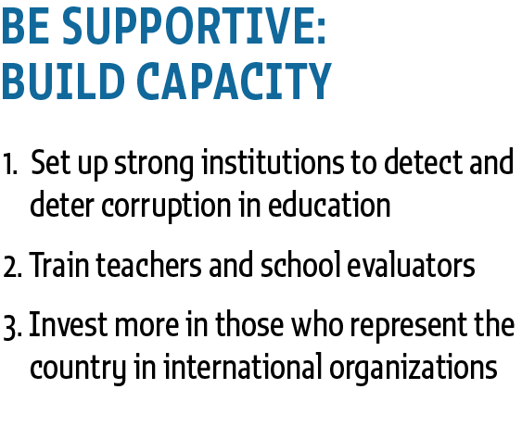
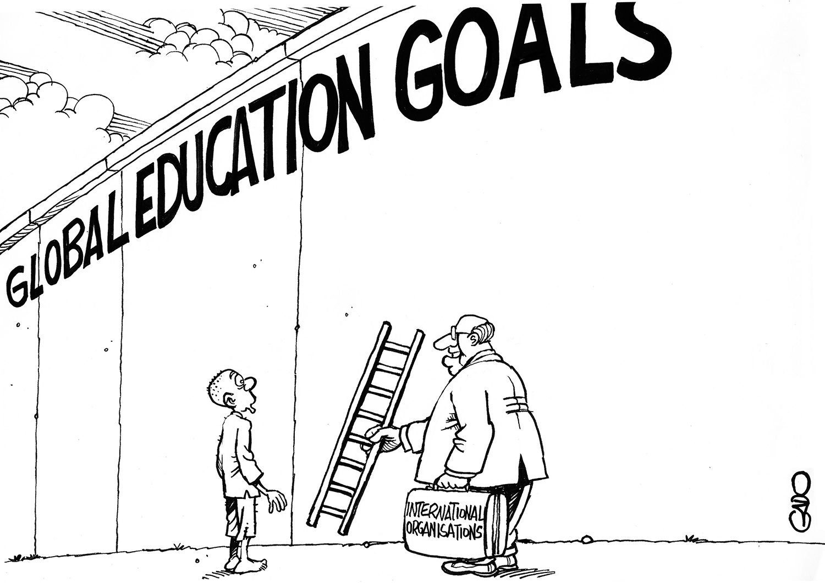
Notes:
Actors should be equipped with the skills needed to fulfil their responsibilities. Governments should ensure strong institutions are in place, including the police, judiciary and auditors, so they can deter, detect and investigate corruption in education. Corruption is a real issue. Construction is a sector well known for having high amounts of corruption. Yet in the European Union, education is even more at risk of corruption than the construction sector.
Governments should train teachers and teacher evaluators. In some countries, inspections tend to focus more on material inputs than on improving learning.
Thirdly, countries need to participate actively and monitor the work of international organizations to challenge the accountability vacuum that exists concerning the role of international organizations and their responsibility in achieving international goals.

Slide 17
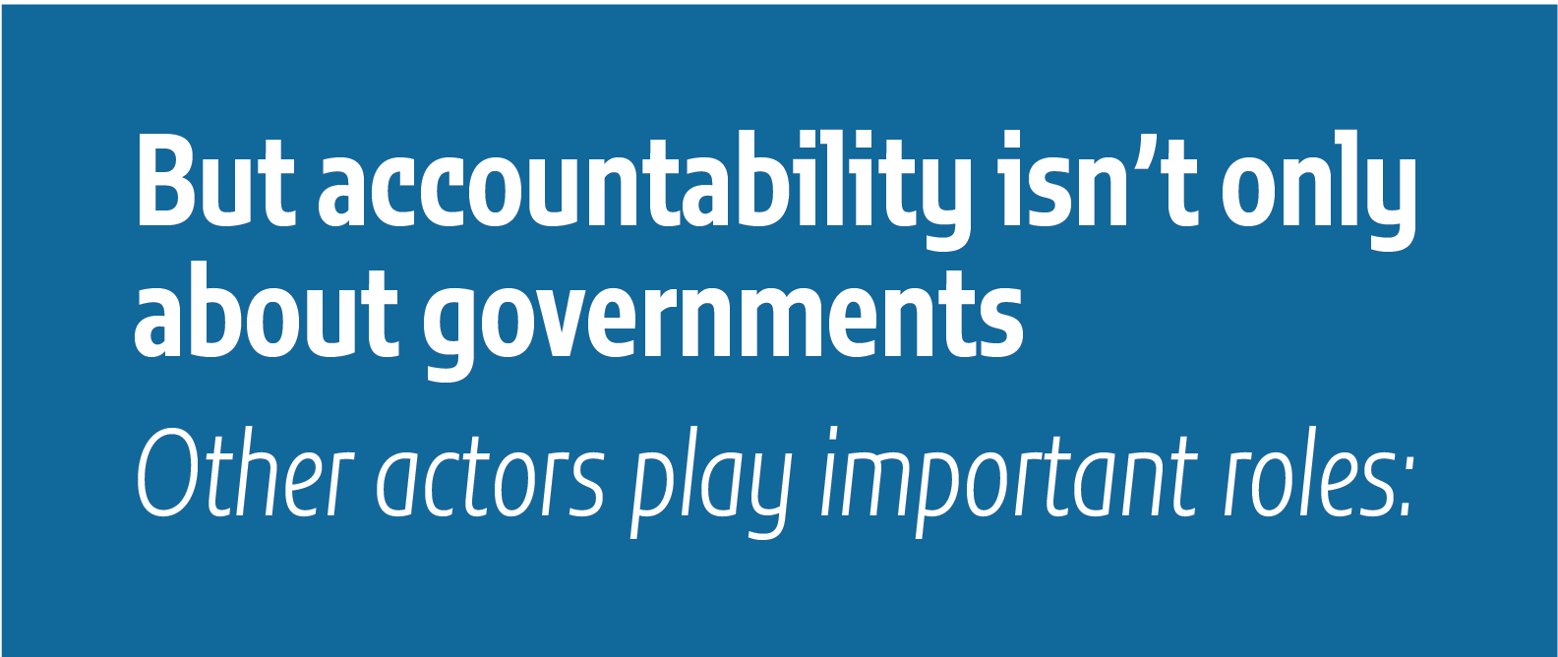
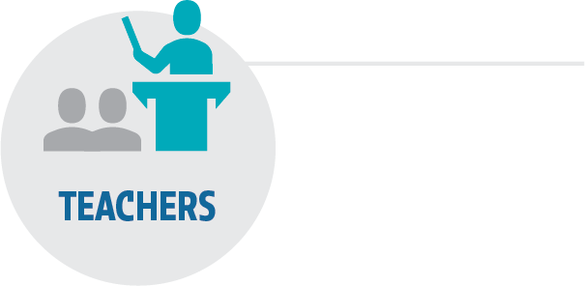
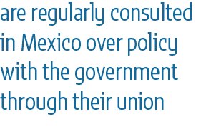
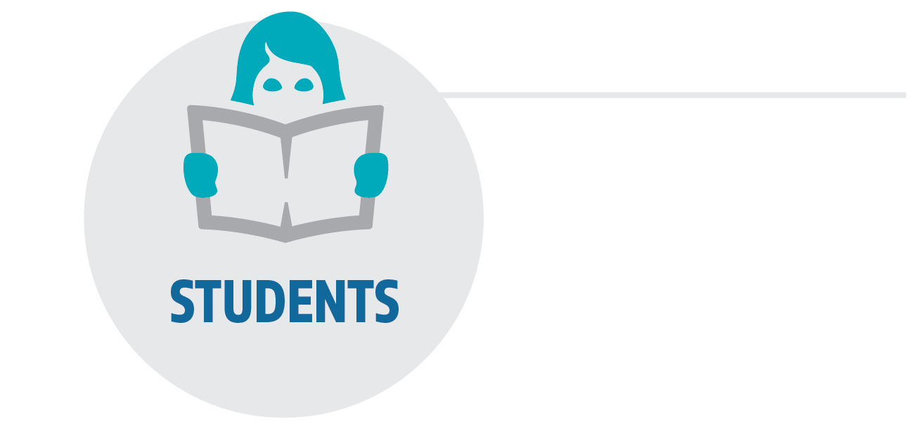
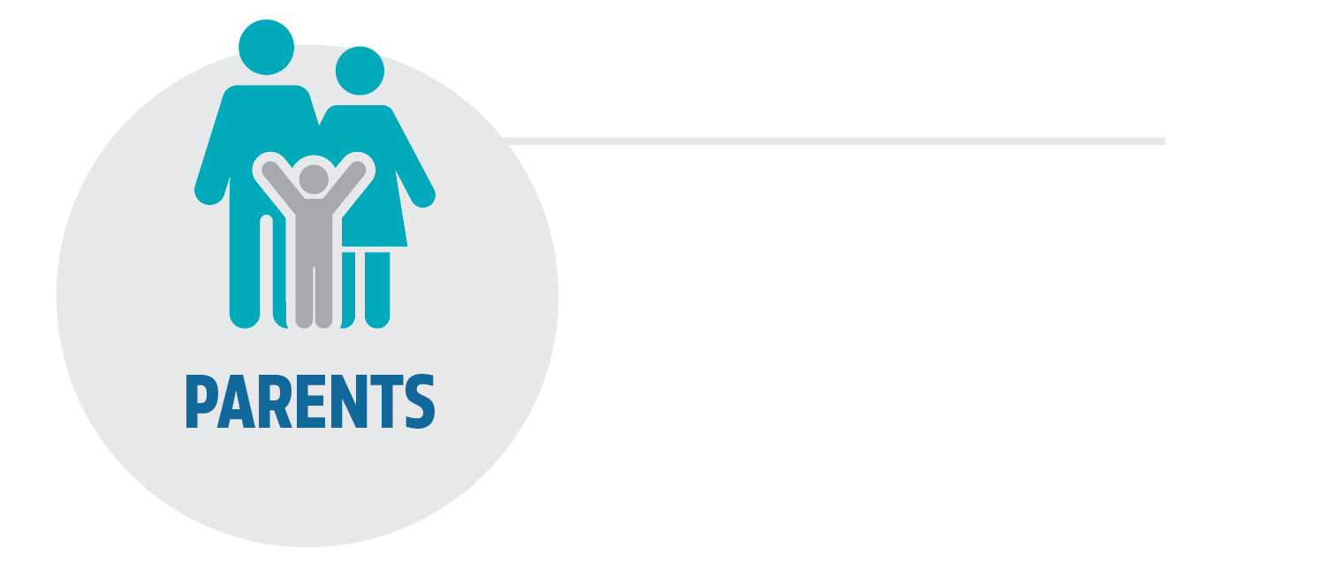
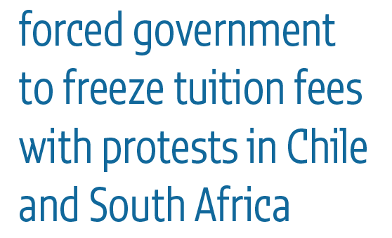
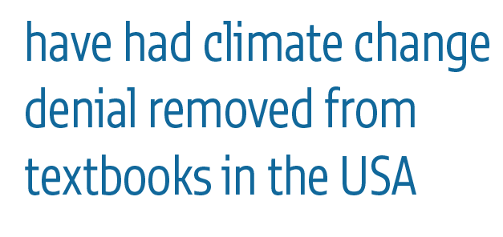
Notes:
But accountability clearly isn’t only about governments. Everyone has a role to play in improving education.
Citizen action can put pressure on governments. Almost a fifth of protests from 2006 to 2013 were over poorly delivered public services, for example.
Teachers, for instance, can hold the government to account for education reform through unions. They are regularly consulted in Mexico over policy with the government, for example.
Students have often swayed policies too. Protests in Chile and South Africa led by students have frozen tuition fees that were penalizing the poor.
Parents have campaigned as well. In the USA, a parent ran a campaign that successfully removed climate change denial from textbooks.
Civil society plays a central role.
- In the Philippines, volunteers monitored textbook delivery points and reduced costs by two-thirds.
- In Argentina, an NGO took the Buenos Aires city government to court over early childhood education spending and won.

Slide 18
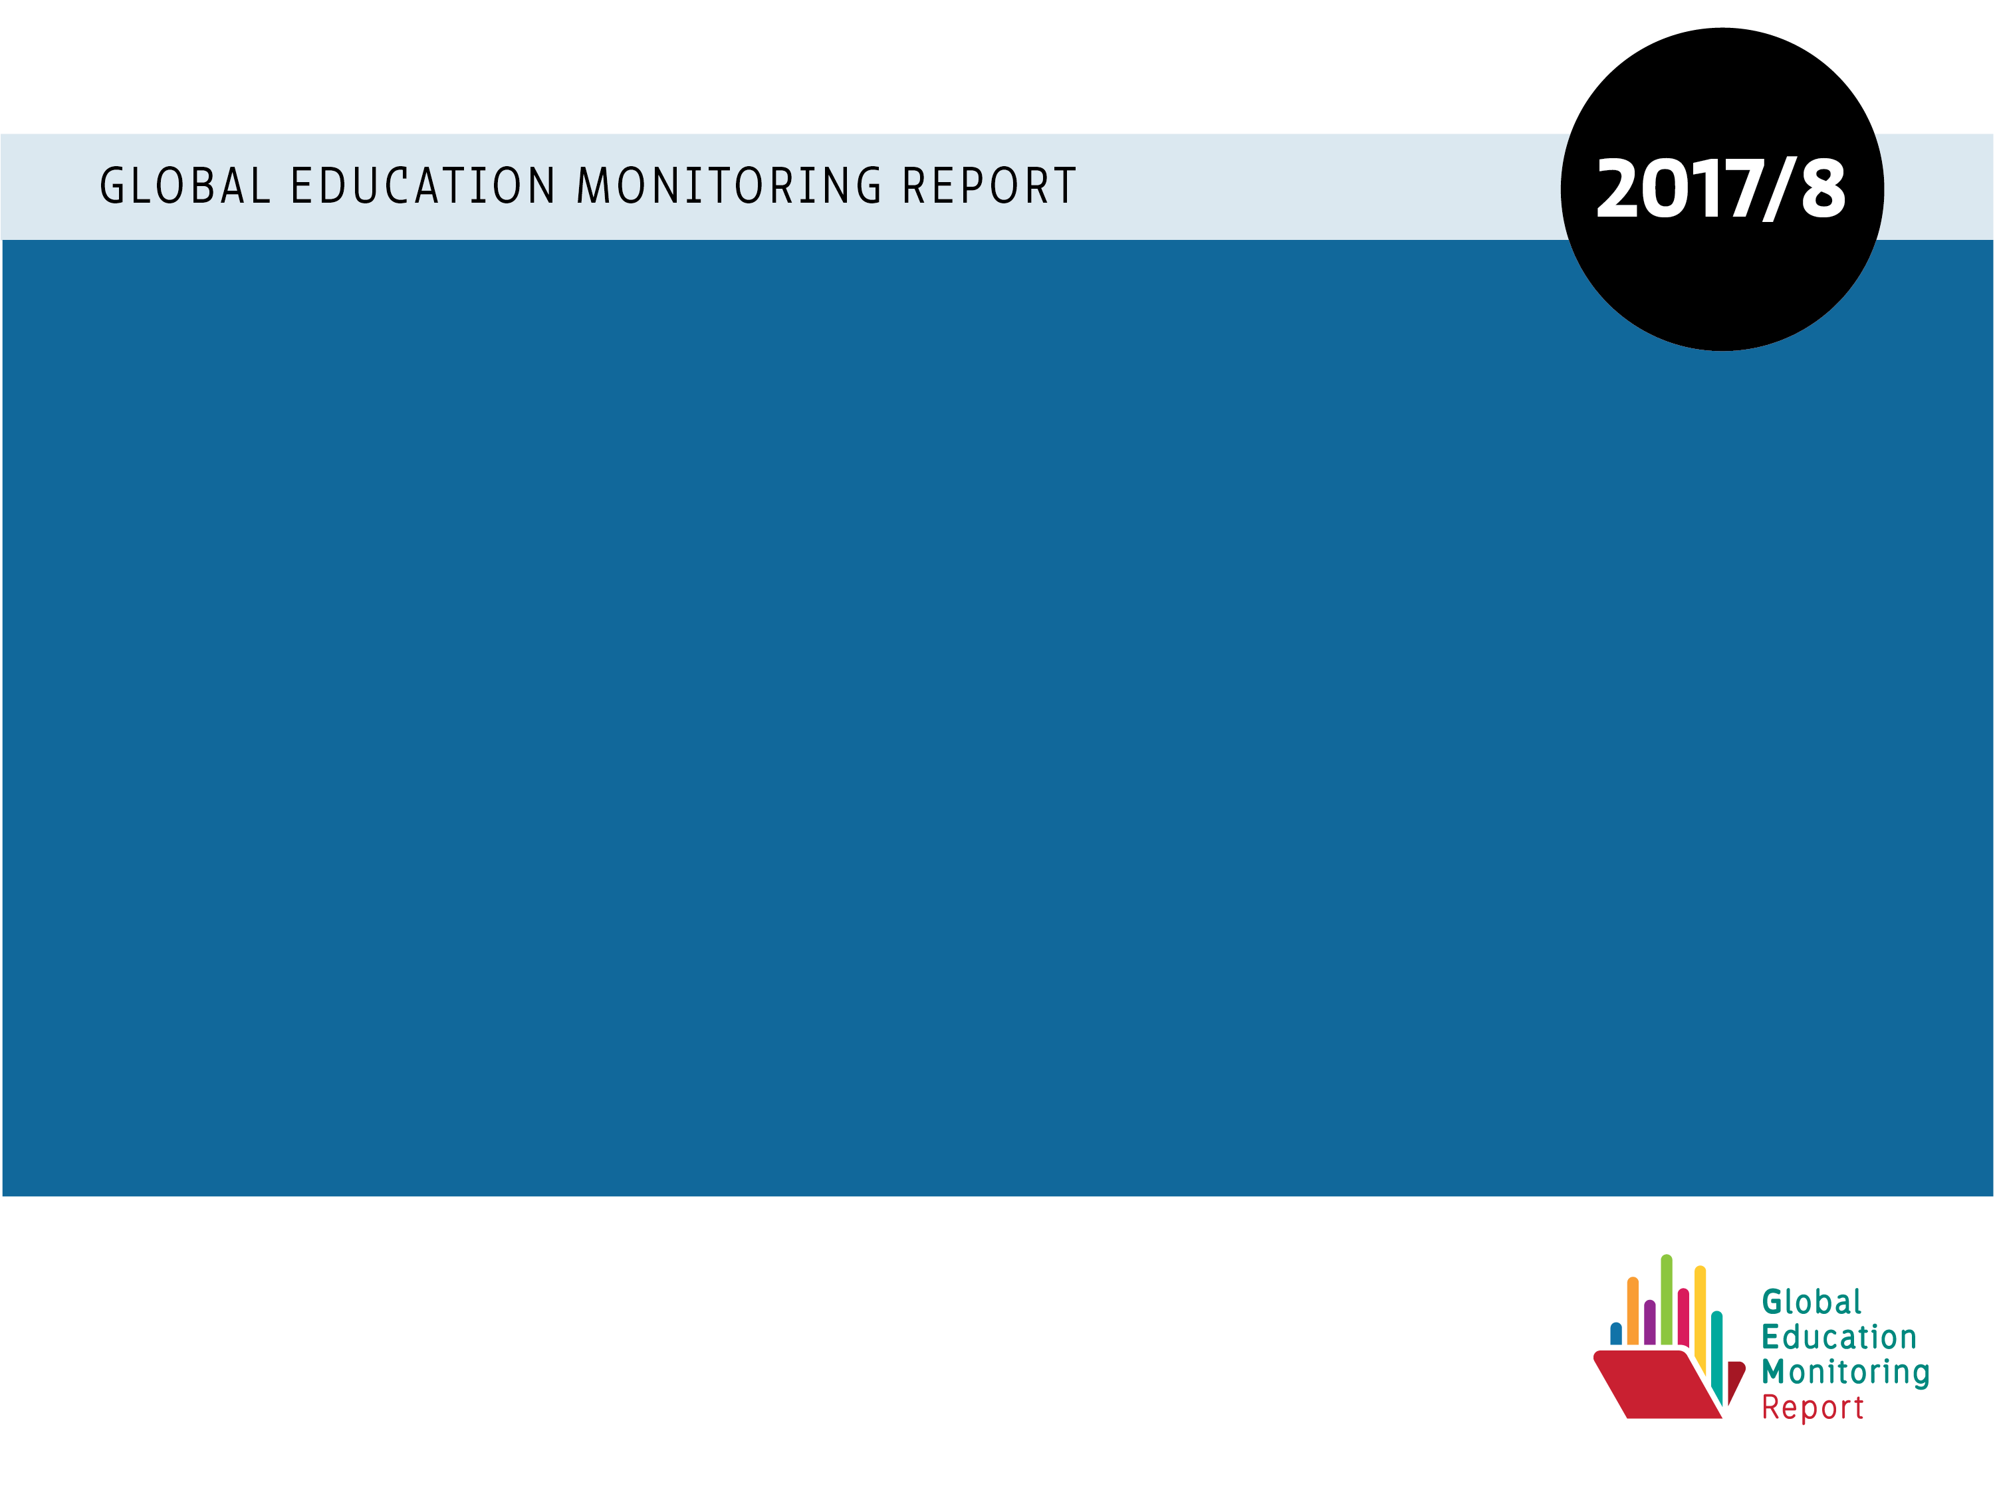
@GEMReport
#CountOnMe
Bit.ly/GEM2017
Notes:
Accountability is increasingly seen as part of a solution to education’s problems.
Our report welcomes this. The GEM Report was created to be an accountability tool, after all, collecting evidence on challenges, identifying those responsible and prompting action.
But we also support accountability as a way of reaching our commitments because hiding in anonymity and not being called to account is likely to prompt complacency.
But we must proceed with caution. Help us get accountability in education right so that we can meet our commitments by sharing our messages and recommendations, and downloading our Report.
Thank you for listening.

