Slide 1
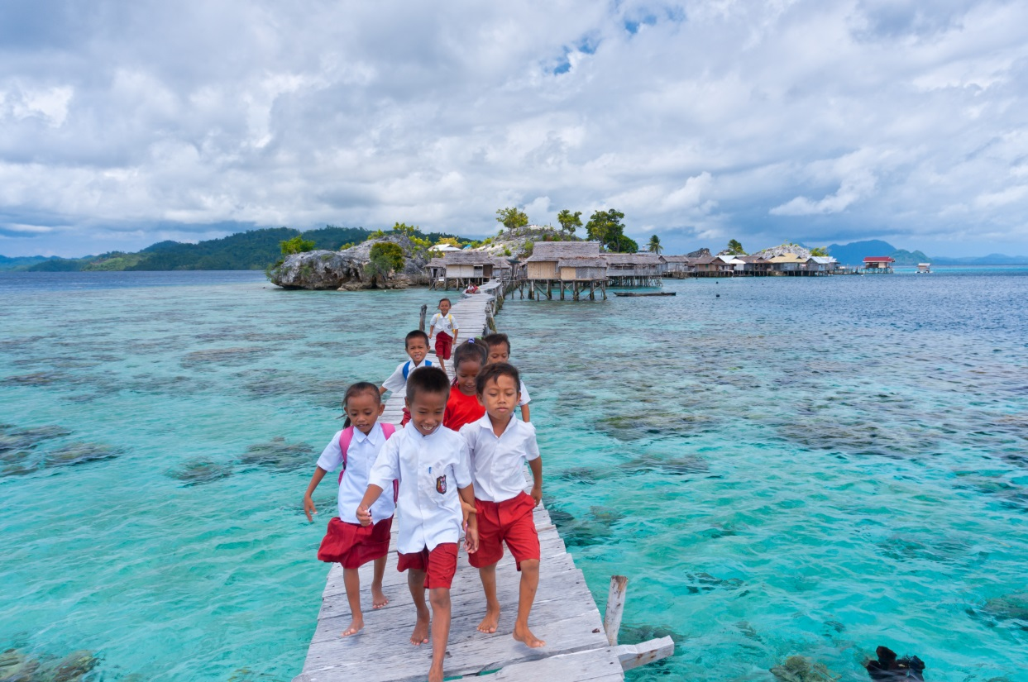
Education for people and planet: Creating sustainable futures for all
Aaron Benavot
6 September 2016
#SDG4All
@GEMReport
Notes:
[introduce yourself]
A year ago, in September 2015, the member states of the United Nations agreed on a new sustainable development agenda with 17 goals to be achieved by 2030. This includes a global goal on education.
Member states also outlined a process to follow up and review progress, globally and by goal.
This is the first report in a fifteen-year series to monitor progress on education in the new sustainable development agenda.

Slide 2
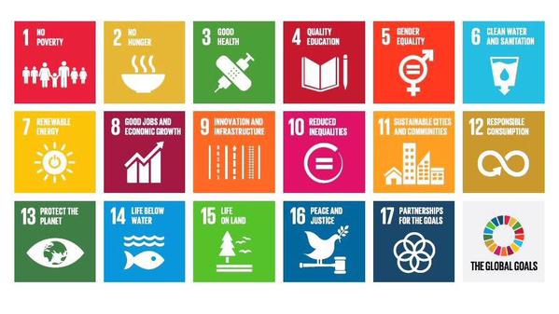
SUSTAINABLE DEVELOPMENT GOALS
Sustainable Development Goals
merge development (MDG 2000-2015) and environment (Rio 1992-) agendas
17 goals with 169 targets
adopted by UN Member States in 2015
to be achieved by 2030
SDG 4 on education
Ensure inclusive and equitable quality education and promote lifelong learning opportunities for all
1 goal with 7 targets and 3 means of implementation
merges and significantly expands development (MDG 2000-2015) and EFA (Jomtien/Dakar 1990-2015) agendas
Global Education Monitoring Report
mandated to monitor and report on education progress in SDGs
Notes:
The Sustainable Development Goals are the collective vision of the international community. They merge the previous development agenda known as the Millennium Development Goals and the environment agenda known as the Rio process.
The fourth Sustainable Development Goal (SDG4) focuses on education and aims to ‘ensure inclusive and equitable quality education and promote lifelong learning opportunities for all’.
In turn, SDG4 merges and significantly expands upon the Millennium Development Goals and the Education for All agendas in education, which guided the international community until 2015.
When representatives of the international education community convened the World Education Forum in May 2015, it gave the Global Education Monitoring Report (or GEM Report) a mandate to monitor education commitments in the new sustainable development agenda.

Slide 3
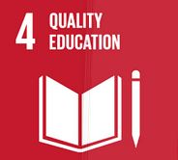
From commitment to action
Global goal SDG4: “Ensure inclusive and equitable quality education and promote lifelong learning opportunities for all”
7 Targets (4.1 – 4.7) and 3 Means of Implementation (4a-c)
(in total 10 targets)
11 Global Indicators and 32 Thematic Indicators
(not yet finalised)
Measures: specific data to measure each indicator
Notes:
Moving from commitment to action the international community has proposed 11 global indicators to monitor progress on the 10 targets of SDG4. Countries will be obliged to report information on each of these 11 global indicators. The international education community has also proposed an additional 32 indicators, called thematic indicators, that would help give a wider view of progress over the next fifteen years.
This Report analyses each target and their respective indicators in detail, raising substantive issues and identify gaps where further work is needed.
In addition, it provides emerging evidence on baselines for selected indicators. It is important to say that many indicators have not yet been measured on a global scale, especially those related to learning outcomes. The next three slides show only some of the Report's findings from the monitoring part.

Slide 4
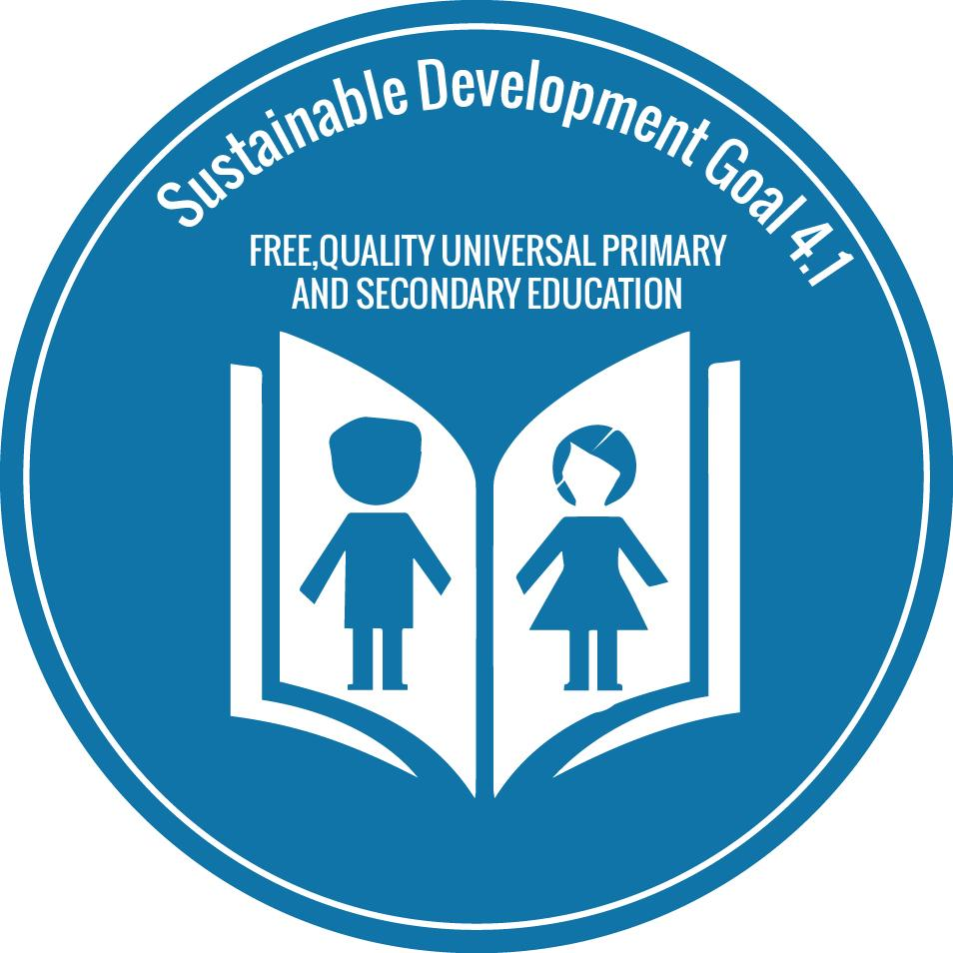
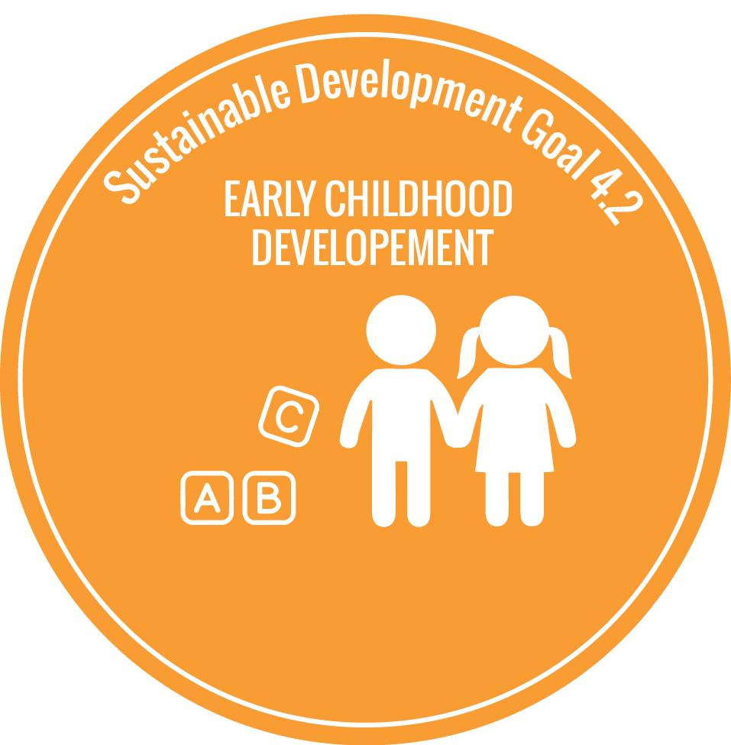
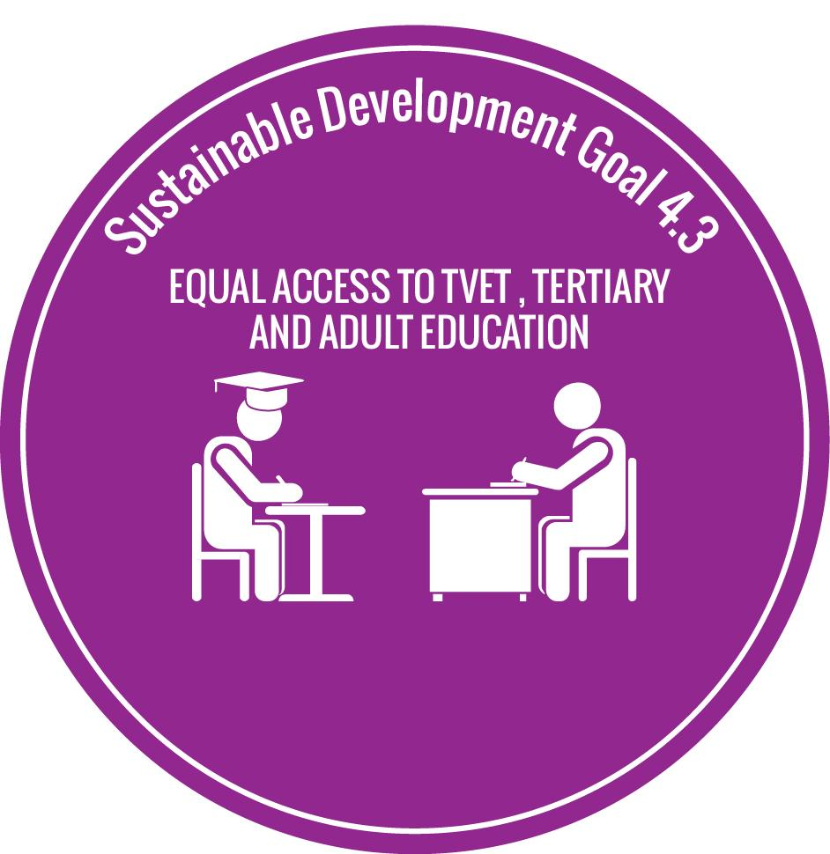
MONITORING SDG 4: SELECT FINDINGS (1)
Target 4.1: Primary and secondary education
263 million children, adolescents and youth are out of school.
Target 4.2: Early childhood care and education
Pre-primary education is compulsory for at least a year in 50 countries
Target 4.3: TVET, higher education and adult education
207 million are now enrolled in tertiary education worldwide
Less than 1% from the poorest households complete 4 years or more of tertiary education.
Notes:
Against the first target (4.1) of universal completion of primary and secondary education by 2030, there are still 263 million children, adolescents and youth out of school according to UIS in 2014.
Against the third target (4.3), while more than 200 million students are now enrolled in higher education, inequalities abound: less than 1% of youth from the poorest households completing four years or more of tertiary education at the moment.

Slide 5
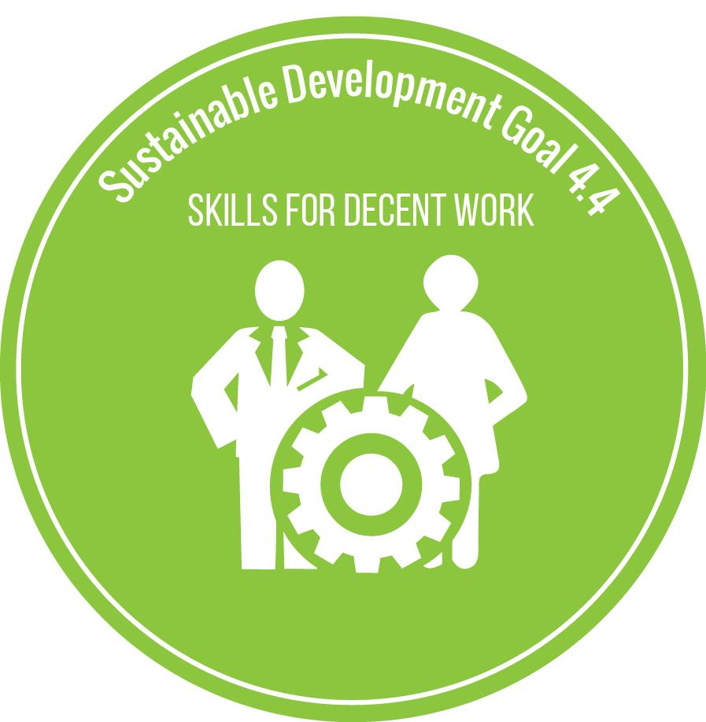
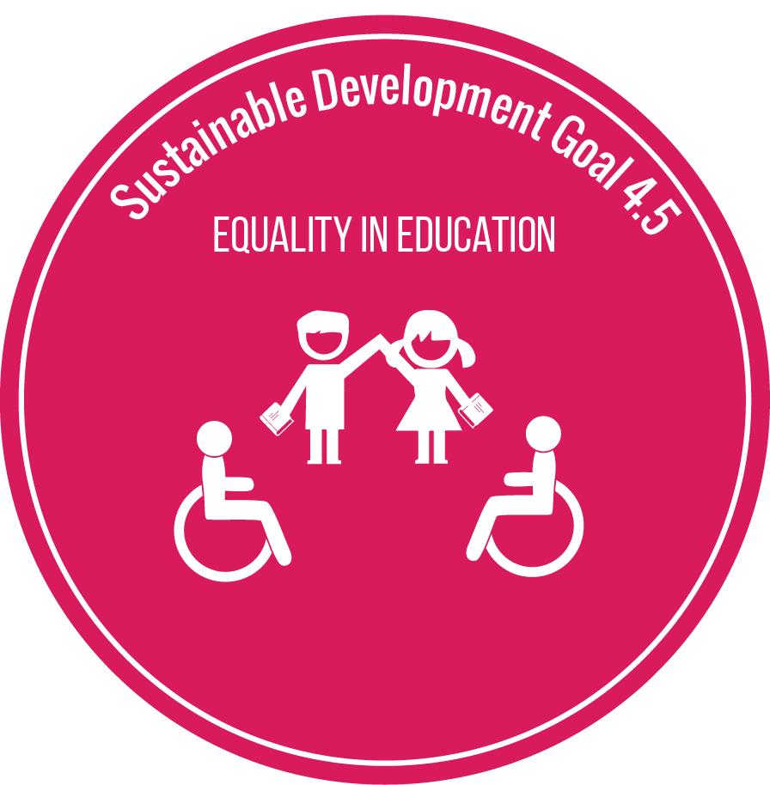
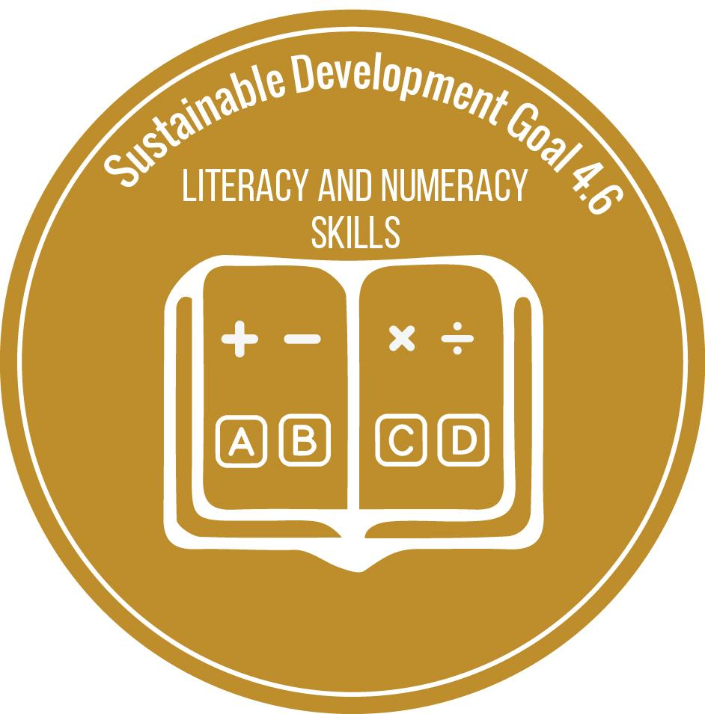
MONITORING SDG 4: SELECT FINDINGS (2)
Target 4.4: Skills for work
Possessing strong reading skills doubles the probability of having a decent job; only a third of adults are financially literate.
Target 4.5: Inequality
In 2014, 63% of countries achieved gender parity in primary, 46% in lower secondary and 23% in upper secondary.
For every 100 among the richest youth only 36 of the poorest youth complete primary education.
Target 4.6: Literacy and numeracy
Only 6% of adults in many poor countries participated in a literacy programme.
Notes:
For the fourth target on skills for work (4.4), we have found that having strong reading skills doubles the probability of having a decent job.
Related to the fifth target on inequalities in education (4.5), we have found that gender disparities increase by education level and that vast wealth gaps remain: for every 100 of the richest youth, only 36 of the poorest youth are completing primary education.

Slide 6
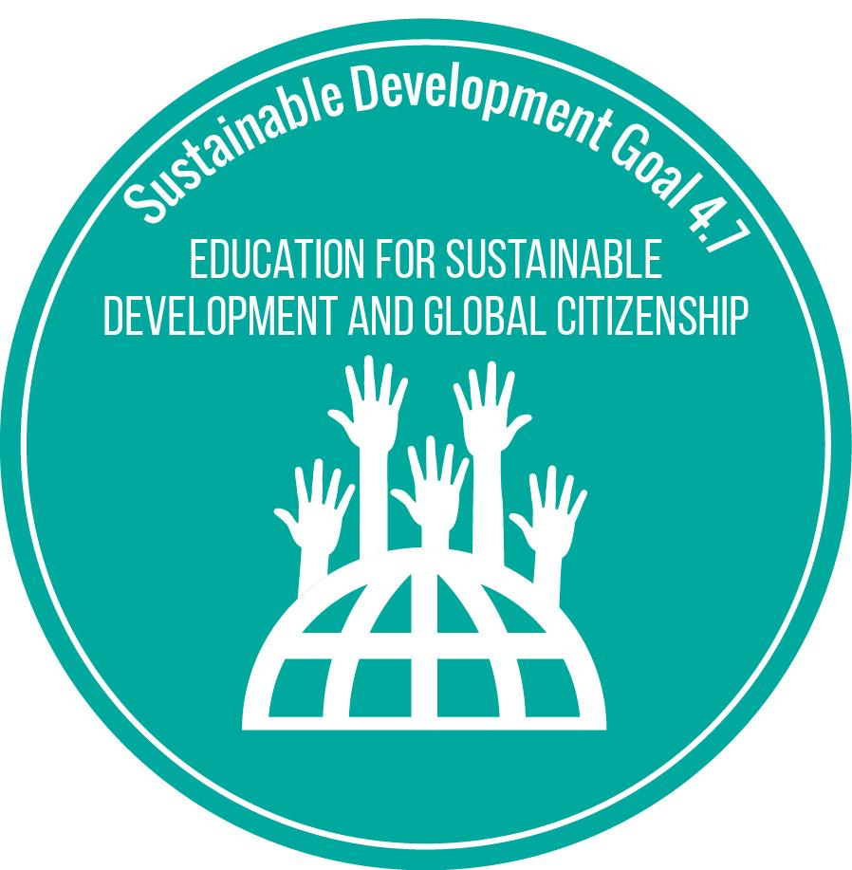
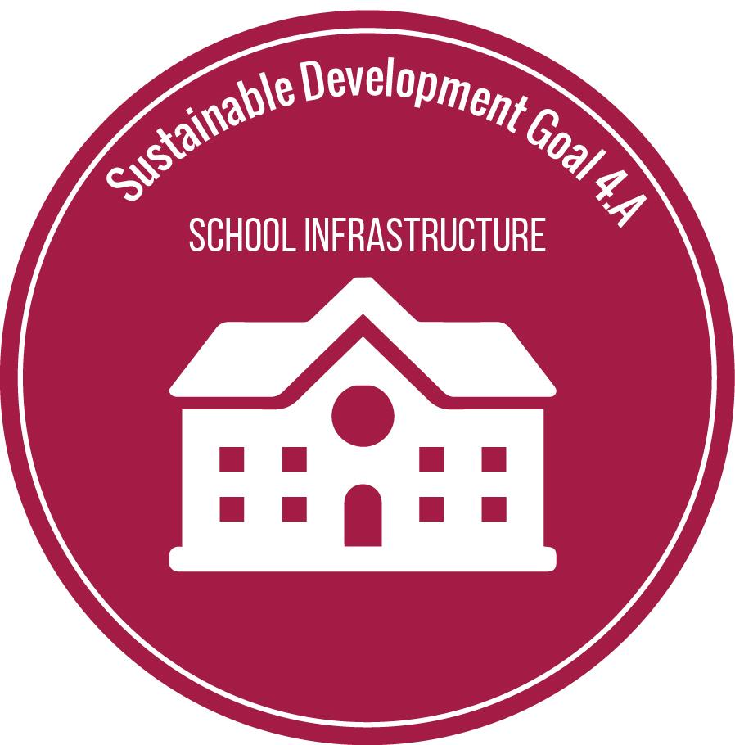
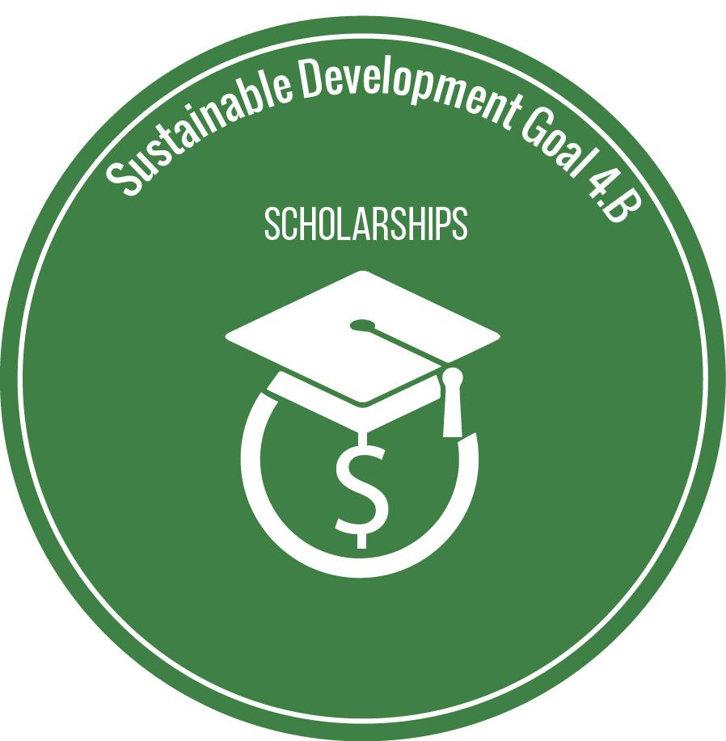
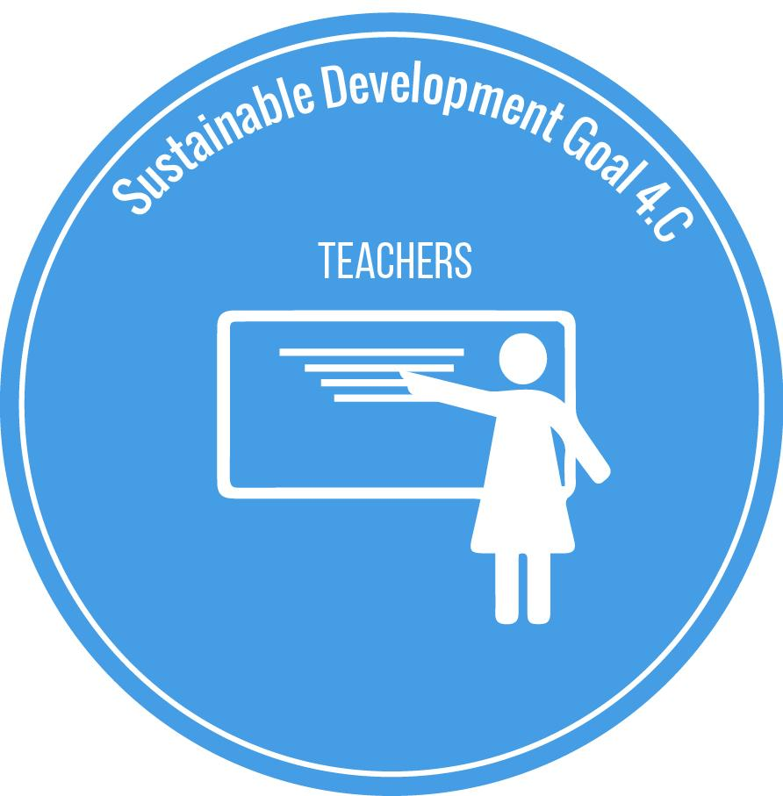
MONITORING SDG 4: SELECT FINDINGS (3)
Target 4.7: Sustainable development and global citizenship
Half of curricula make no mention of climate change
Target 4a: Education facilities and learning environments
3 in 10 primary schools lack an adequate water supply
Target 4b: Scholarships
Fewer than 25,000 scholarships were offered by governments in 2015
Target 4c: Teachers
In 2014, 82% of teachers had the minimum qualifications required to teach in pre-primary education, 93% in primary, and 91% in secondary education.
Notes:
In the seventh target on education for sustainable development (4.7), new GEM analysis indicates the challenge of mainstreaming ESD and GCED in curricula: for example, while 73% of 78 countries with data included the key term ‘sustainable development’, only 36% included the notion of ‘climate change’. The terms ‘global citizenship’ or ‘global identity’ appeared in the curricula of only 42% of countries.
We are far from providing the education facilities and learning environments envisaged in target 4.a: 3 out of 10 primary schools lack an adequate water supply.
Our own analysis of target 4.b has found that around 25,000 scholarships were offered by governments last year, which reach only 1% of mobile students from developing countries, although a proper mechanism of measuring them is currently lacking.

Slide 7
MONITORING EDUCATION IN OTHER SDGs SELECT FINDINGS (3)
Education is associated with desirable development outcomes, e.g. child mortality rates by maternal education
Notes:
The mandate of the GEM Report also extends in monitoring education in the other SDGs. We explore three possible ways in which this can be done.
First, as the theme of this report shows, education is positively associated with desirable development outcomes and the strength of this relationship needs to be studied over time. For example, child mortality rates in different parts of the world, which are high when mothers have no more than primary education [CLICK TO MOVE TO NEXT SLIDE] drop rapidly when mothers acquire secondary and tertiary education.
Second, education is critical to help nations build capacity to achieve the other SDGs, notably to develop the professionals for key technical and managerial positions.
Third, education beyond schooling also needs to be monitored: the majority of the most critical decisions that need to be taken in the next 15 years will be taken by people who have already left school. Their adult education opportunities will be key.

Slide 8
MONITORING EDUCATION IN OTHER SDGs SELECT FINDINGS (3)
Education is associated with desirable development outcomes, e.g. child mortality rates by maternal education
Notes:
The mandate of the GEM Report also extends in monitoring education in the other SDGs. We explore three possible ways in which this can be done.
First, as the theme of this report shows, education is positively associated with desirable development outcomes and the strength of this relationship needs to be studied over time. For example, child mortality rates in different parts of the world, which are high when mothers have no more than primary education [CLICK TO MOVE TO NEXT SLIDE] drop rapidly when mothers acquire secondary and tertiary education.
Second, education is critical to help nations build capacity to achieve the other SDGs, notably to develop the professionals for key technical and managerial positions.
Third, education beyond schooling also needs to be monitored: the majority of the most critical decisions that need to be taken in the next 15 years will be taken by people who have already left school. Their adult education opportunities will be key.

Slide 9
RECOMMENDATIONS FOR MONITORING SDG4
Build capacity
Education ministries should use the findings of household surveys to monitor inequality in their education systems.
Establish a national assessment framework that monitors a range of learning outcomes, including for those who left school early.
A focus on education quality means more than just a focus on learning outcomes: review curricula and textbooks as well.
Monitor a fuller range of lifelong learning opportunities, including adult education.
Share best practices of education policy and systems within organisations of regional cooperation.
Use national education accounts approach to improve monitoring of spending.
Notes:
The Report outlines six key steps that countries should take to strengthen national monitoring of education in the next 3 to 5 years
Countries are not always aware of the extent of education inequality. Outside of Education Management Information Systems in the education ministries, national statistical agencies can produce highly relevant information through household or labour force surveys. Ministries of education should be more involved in the design of such surveys and the use of their results.
Countries should establish or improve the quality of national learning assessments to monitor progress in a range of learning outcomes over time. They should ensure that such assessments are used by administrators, teacher trainers, curriculum developers and others to improve learning. They should also ensure these assessments monitor the skills of those who have left school early.
Assessing the quality of education cannot be reduced to learning outcomes. It should include looking at policies, curricula, textbooks and teacher education programmes, judging them against the way they address tolerance, human rights, and sustainability, for instance.
Schooling alone cannot deliver all the expected outcomes from improved education by 2030. We need to focus on lifelong learning, yet at present, education opportunities available to adults are barely being monitored at all.
Countries should engage in debates and exchange ideas on good practices of key education policies, for example how to address disadvantage in education. Regional organizations can encourage and support these processes, as examples from Europe and Latin America suggest.
Finally, countries should consider adopting a national education accounts approach to help monitor education spending not only from governments and donors but also from households. This would provide important information as to whether the costs are shared fairly.

Slide 10
PROJECTIONS FOR EDUCATION 2030
World is not set to achieve key global education commitments until 2084.
YEAR
Global average
2015
2042
2059
2084
YEAR
Universal primary completion
Universal Lower secondary completion
Universal Upper secondary completion
SDGs adopted
2030
2042
2059
2084
Universal primary completion
Universal Lower secondary completion
Universal Upper secondary completion
Education 2030
deadline
Education 2030
deadline
Southern Asia
2051
2062
2087
Sub-Saharan Africa
2080
2089
After 2100
Notes:
The 2016 GEM Report has assessed the likelihood of achieving the target of universal primary and secondary completion by 2030.
The message is stark: if past rates continue, not even the EFA goal of universal primary completion would be achieved by 2030. Rather, the world is set to achieve universal upper secondary completion half a century late.
Southern Asia is just behind the global average, estimated to achieve universal upper secondary completion in 2084. Sub-Saharan Africa falls behind that, estimated to achieve the target at the end of the century.
It is clear that we need an unprecedented break with past trends if current education commitments are to be achieved.

Slide 11
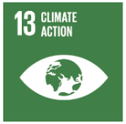
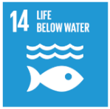
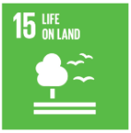
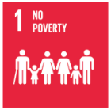
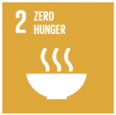
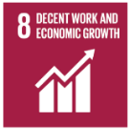
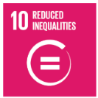
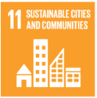
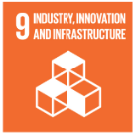
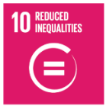
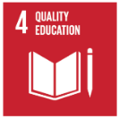
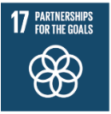
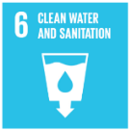
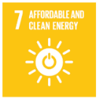
2016 GEM REPORT: THEMATIC CONTENT
Planet: environmental sustainability
Peace:
political participation, peace and justice
Prosperity: inclusive and sustainable growth
Place:
inclusive and sustainable cities
People: inclusive social development
Partnerships for sustainable development
Notes:
The other part of the GEM Report looks at the multiple links and synergies between education and the other 16 goals in the sustainable development agenda. These are grouped, as you can see on this slide into six chapters focusing on the planet, prosperity, people, peace, place and partnerships.

Slide 12
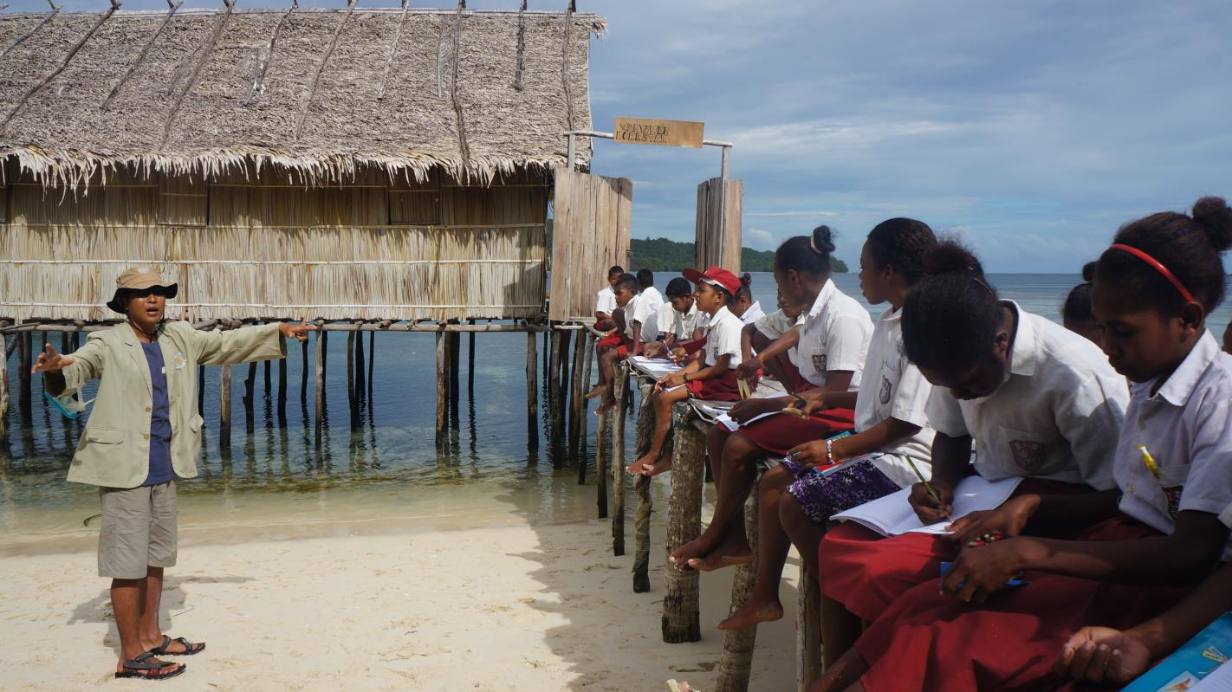
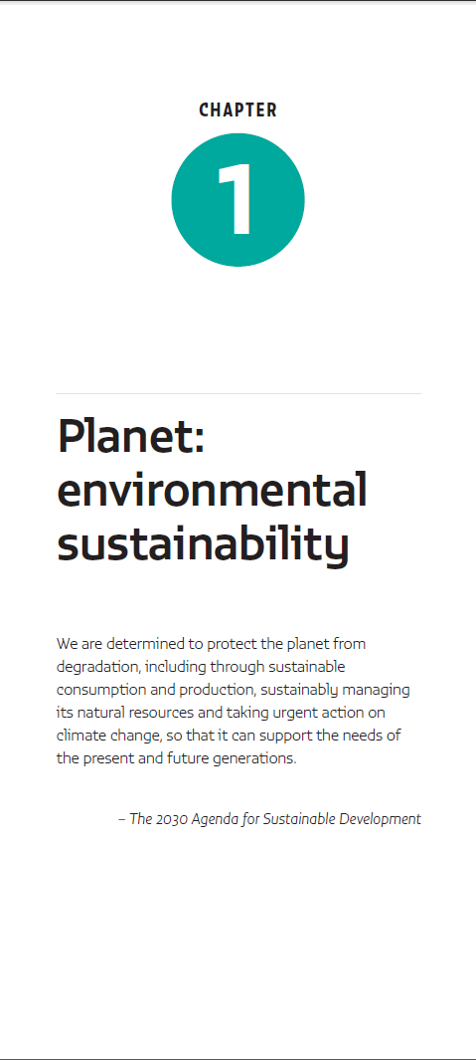
Living sustainably requires a huge shift in mindset and education must be a part of that change
Credit: Nur’aini Yuwanita Wakan
Notes:
The sustainable development agenda draws together those working on all aspects of human development and the environment for the first time.
It is why the first cross-sectoral links our Report explores are between education and environmental sustainability.

Slide 13
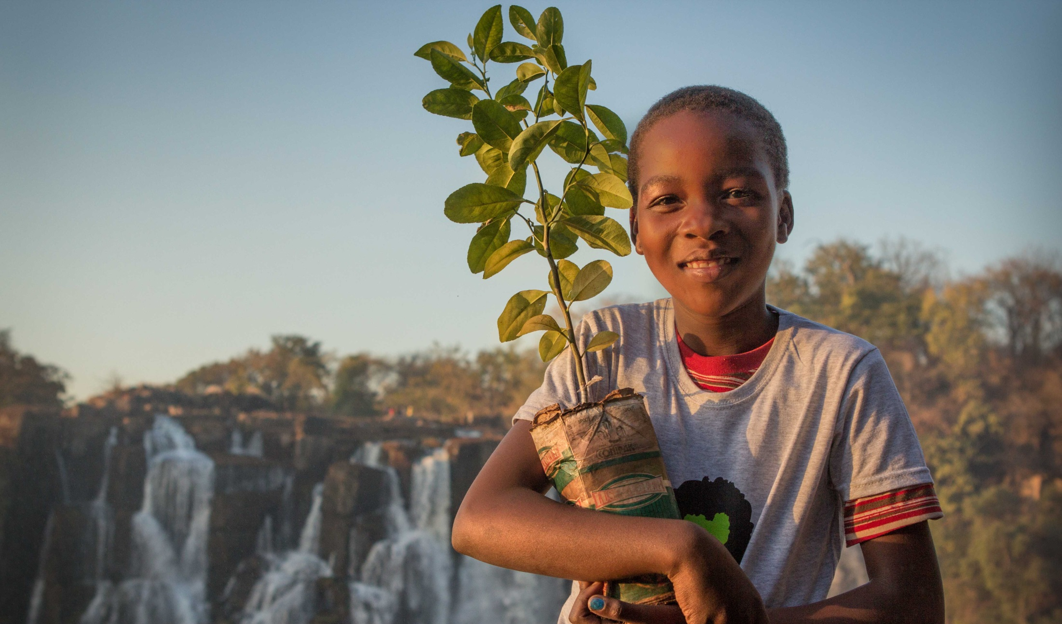
PLANET
Education can help with the shift to a more sustainable way of living.
Credit: Sydelle Willow Smith / GEM Report
Education is proven to be the best tool for climate change awareness
Education is the most effective means for addressing population growth
Notes:
Education can help with the shift to a more sustainable way of living.
It shapes values and perspectives, and is proven to be the best tool for climate change awareness. Schools help students understand a given environmental problem, its consequences and the types of action required to address it.
Education does not just bring awareness but also helps develop skills that can reduce or stop unsustainable practices and has a key role to play in addressing environmental challenges.
One of the biggest strains on the environment, for instance, is population growth. Education, especially of girls and women, is the most effective means of addressing this growth, increasing women’s autonomy over fertility-related decisions.”

Slide 14
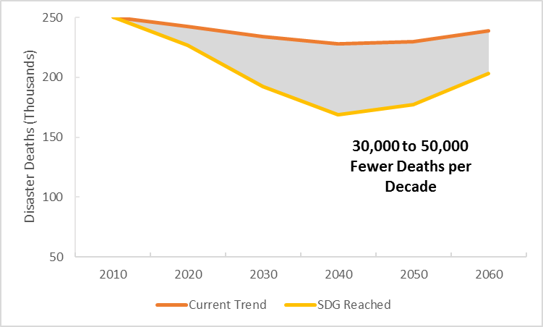
PLANET
Education also enhances people’s resilience to climate-related risks
Notes:
ducation also enhances people’s resilience to climate-related risks. and encourages their support for and involvement in mitigation actions. Broadening access to education has been shown to be more effective against the effects of climate change than investment in infrastructure such as sea walls and irrigation systems.
Our projections show that if the SDG education target is reached, there would be up to 50,000 fewer deaths from future natural disasters per decade, assuming that the rate of disasters remains the same or increases.

Slide 15
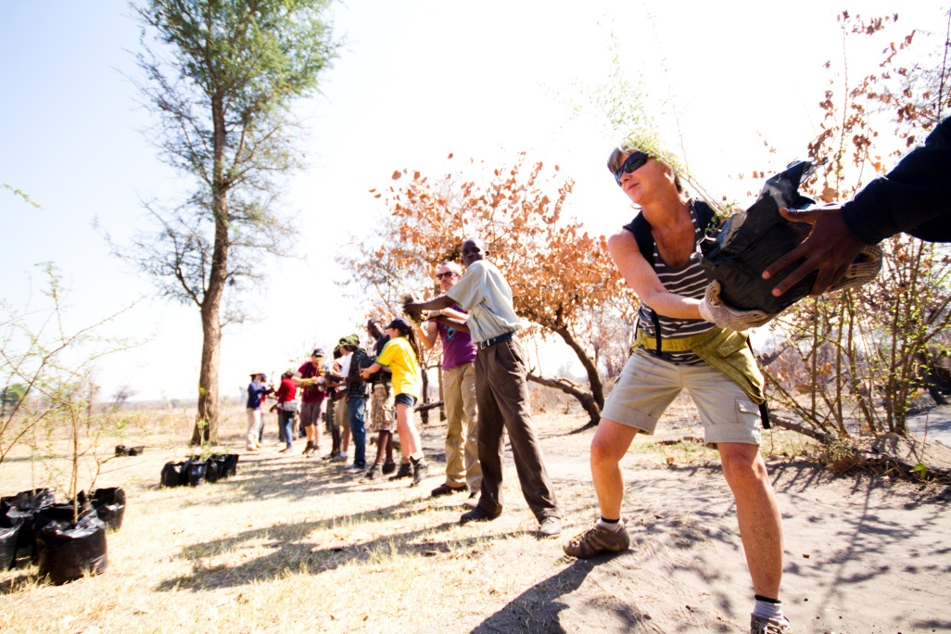
PLANET
Learning for the future of our planet must happen in schools, in communities and the workplace
Credit: Sydelle Willow Smith / GEM Report
Notes:
One key takeaway is that we must stop thinking of learning as something that only happens in school if we are to start living in a more sustainable manner.
Certainly, schools must become more green, changing their pedagogy, linking up with communities and increasing their connections with nature.
But beyond formal education, government agencies, religious organizations, non-profit and community groups, labour unions and the private sector can all help change individual and collective behaviour.
This can happen through awareness campaigns about an environmental problem, and its solution such as Ethiopia ran in 2015, for instance, aimed at encouraging solar lighting.
The workplace is likewise an essential centre for environmental learning through training and practice
There is an appetite for this. A 2008 survey reported that over 40% of global executives thought it important for their companies to align sustainability with their business.

Slide 16
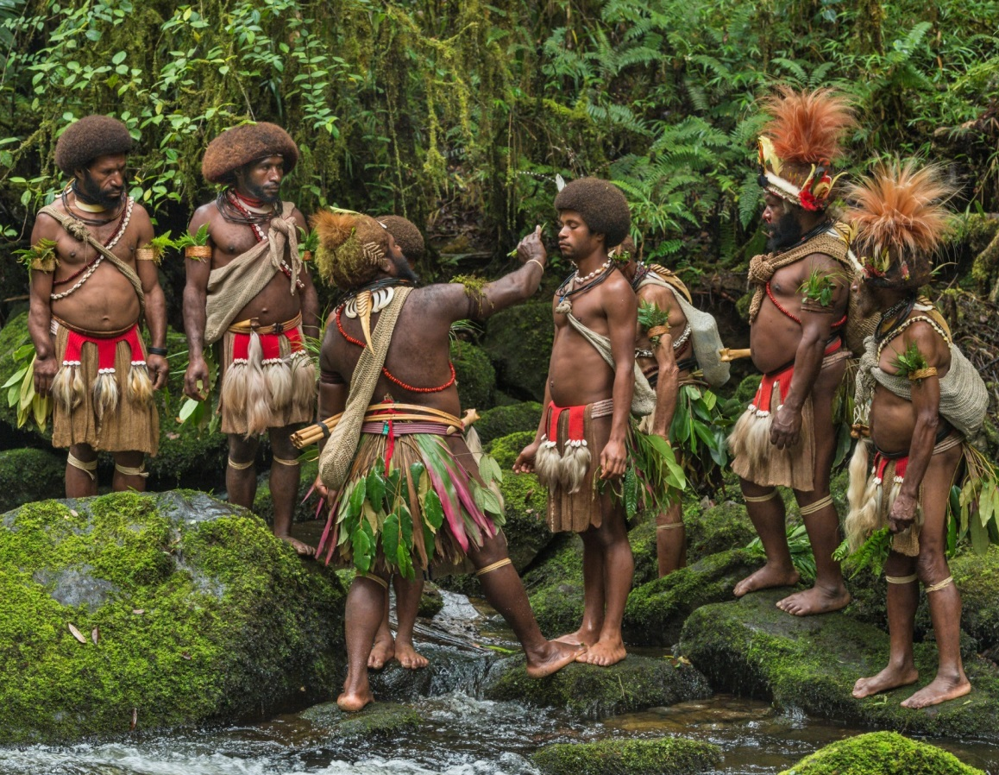
PLANET
Education systems must be careful not to encourage unsustainable lifestyles
Relevant knowledge and sustainability practices can be learned from indigenous communities especially in farming, conservation and climate change mitigation
Credit: Marc Dozier
Education systems should respect local cultures, integrate indigenous knowledge and provide instruction in local languages
Notes:
However, education systems can sometimes contribute to unsustainable practices, including overconsumption of resources.
Traditional – especially indigenous – knowledge in such areas as agriculture, food production and conservation has played an important role in environmental sustainability for centuries. It has recently contributed to disaster early warning systems, climate change adaptation and resilience.
To ensure that education systems are not destroying local knowledge systems, they should promote diversity in curricula and establish policies and programmes that protect and respect local languages.
The Alaska Rural Systemic Initiative in the United States, in which students interact with indigenous elders, is an example of schools learning from indigenous knowledge we can take from.

Slide 17
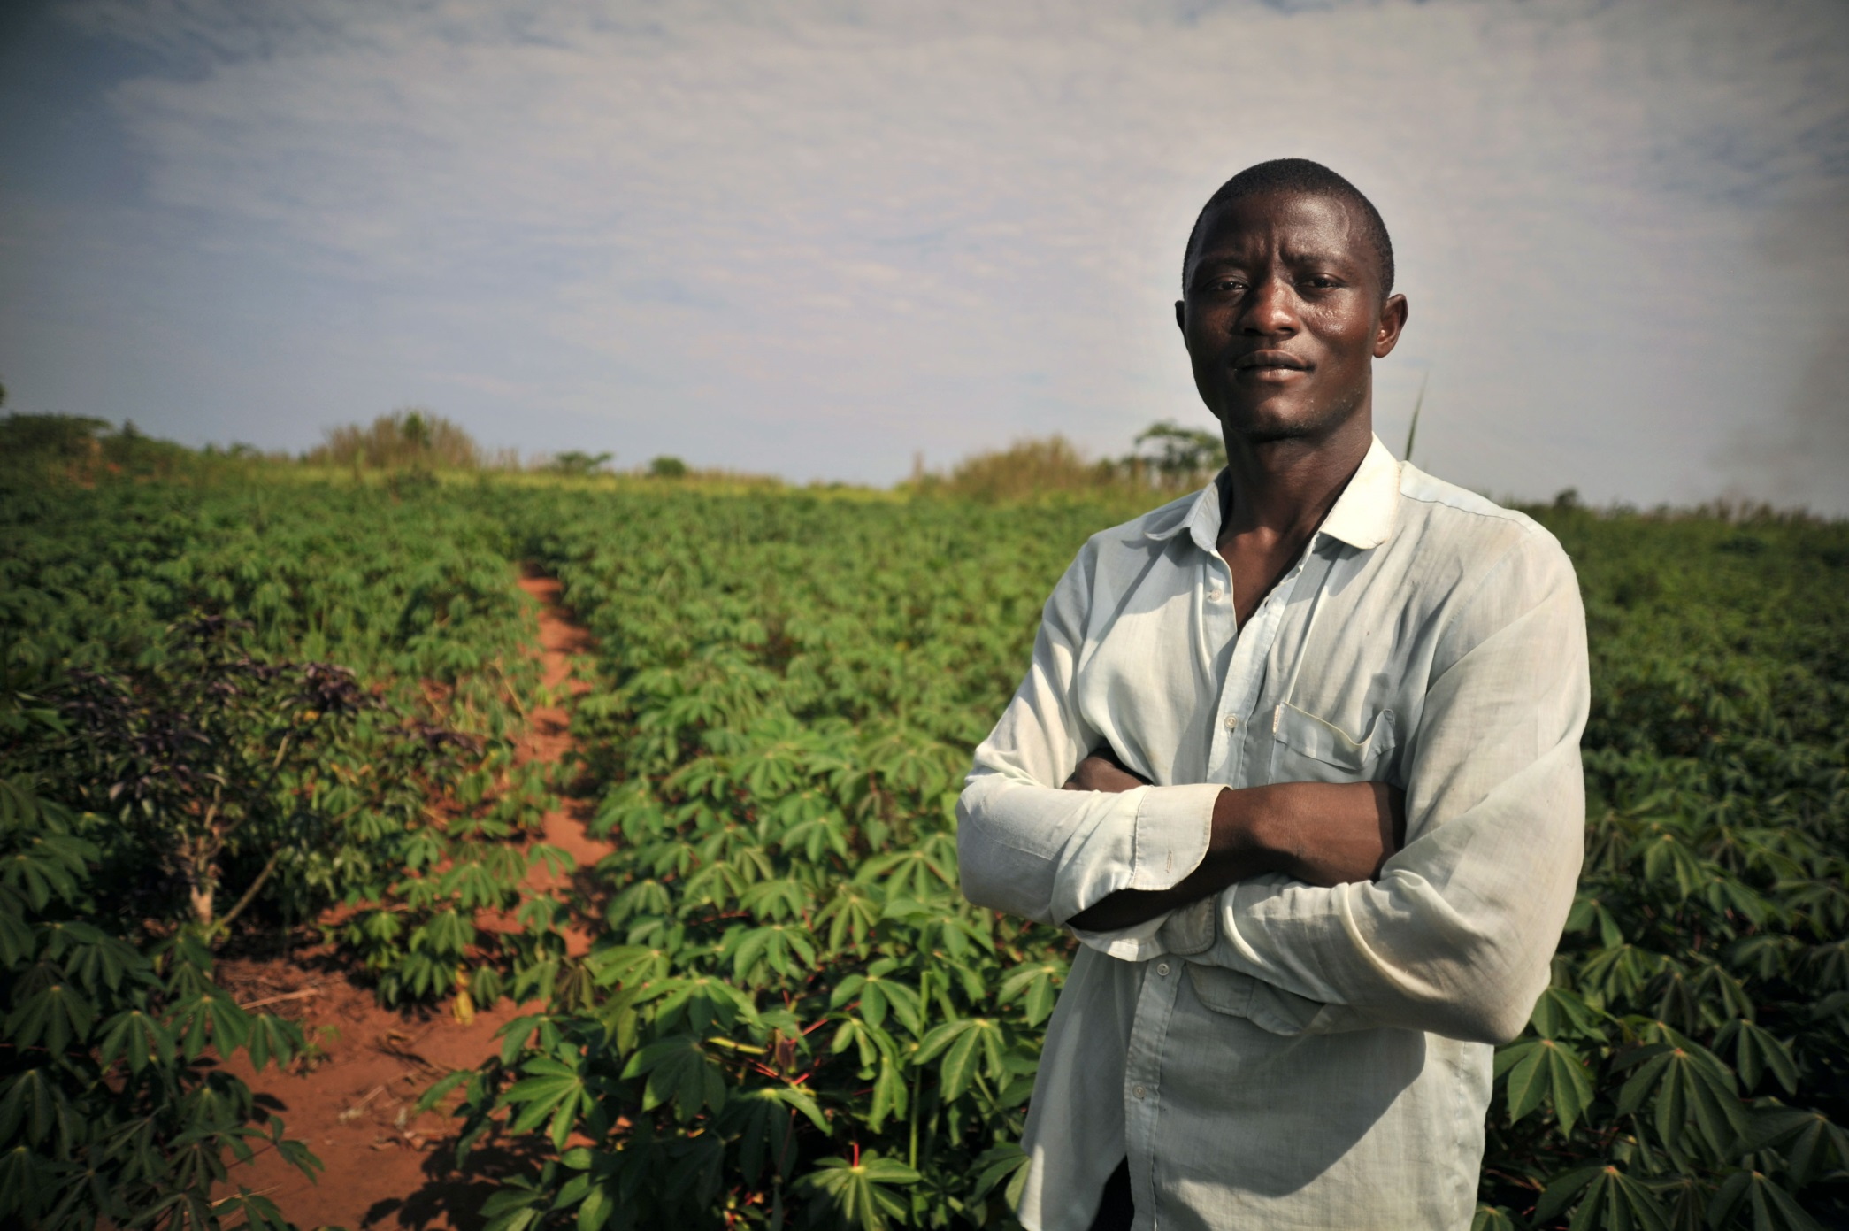
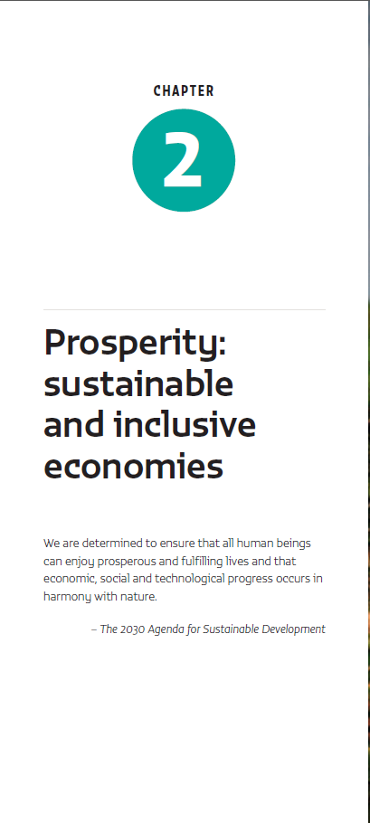
An inclusive education ensures economic growth is sustainable and doesn’t leave anyone behind
Credit: Ivy Grace F. Rivera - Philippines
Notes:
Education has a role for making production and consumption sustainable, for supplying skills for the creation of green industry and orienting higher education and research towards green innovation.
Education can also protect against abusive informal labour and working poverty, ensuring that economic growth does not leave anyone behind.

Slide 18
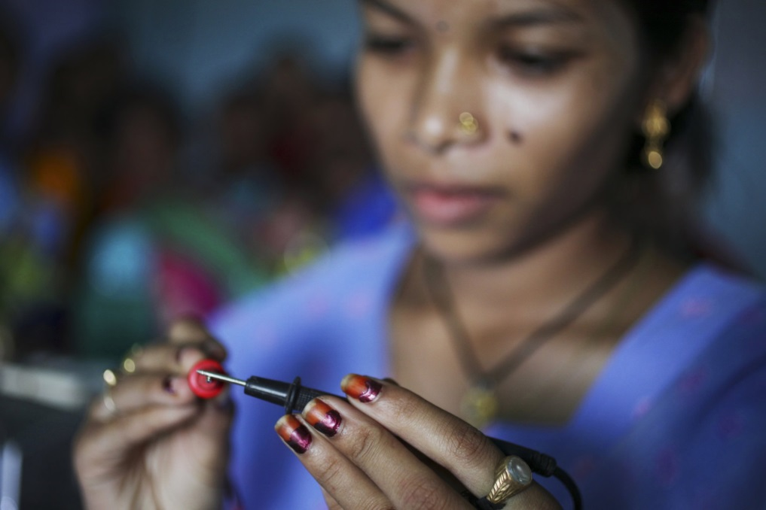
PROSPERITY
Education can help economies transform and innovate and provide skills for green jobs
Governments need to increase energy research and development by up to fivefold annually to shift to low carbon intensity
Credit: Dominic Sansoni / World Bank
Notes:
The greening of today’s industries and the growth of new green companies will require new skills and calls for continuing education and training for workers, often on the job.
Through research and innovative development education can support the shift to green growth. It is estimated that governments need to increase energy research and development by up to fivefold annually to achieve a quick transition to low carbon intensity.
However, many countries, including many in sub-Saharan Africa, have halted or reduced investment in agricultural research, which needs to be reversed.

Slide 19
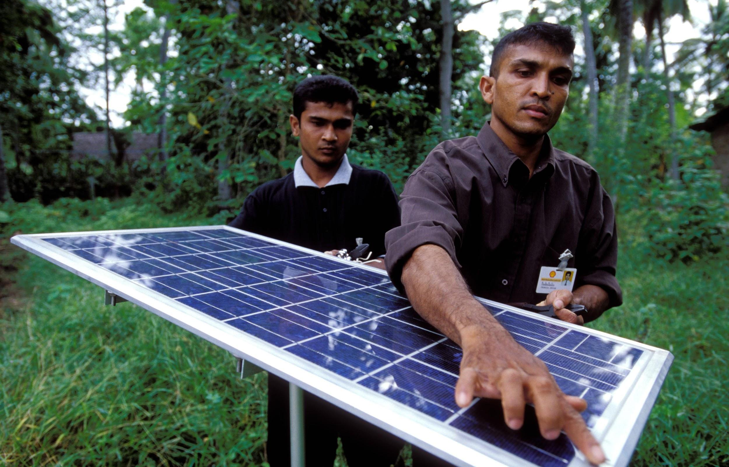
PROSPERITY
Education can help with the shift towards sustainable farming and food production
Credit: Dominic Sansoni / World Bank
Farmers have increased productivity by 12% and net income by 19% with field schools
Notes:
An economic sector in urgent need of becoming more sustainable is agriculture, which accounts for 33% of greenhouse gas emissions.
Education can help with this shift, giving farmers the right skills and knowledge, and producing innovative agricultural research.
In addition, farmers urgently need help stepping up their productivity to feed our increasingly growing population.
Our report shows that field schools and extension programmes helped farmers increase productivity by 12% and their net income by 19% at the same time.

Slide 20
PROSPERITY
Education increases economic growth
If low income countries achieved universal upper secondary education by 2030, we’d lift 60 million out of poverty by 2050
Credit: AusAID
Notes:
For countries to prosper, investment in good quality secondary and tertiary education is a must.
Our projections have shown that were low income countries to reach their target of universal upper secondary education by 2030, then by 2050, per capita earnings would increase by 75% and the percent of people living in poverty would significantly decline, thereby lifting 60 million people out of poverty.

Slide 21
PROSPERITY
Education increases economic growth that doesn’t leave anyone behind
Percentage in working poverty
If workers from rich and poor backgrounds had the same education, working poverty among the poor would be reduced by 39%
Notes:
Education can also ensure this economic growth doesn’t leave people behind, firstly, by helping people find work, but perhaps more importantly, by helping people find decent work – work that pays them a liveable wage, something that almost 90% of workers in low-income countries cannot say they have.
New analysis for this report shows that 39% fewer workers from poorer backgrounds would be in low paying informal work and in working poverty if they attained the same education level as workers from richer backgrounds.

Slide 22
PROSPERITY
Education systems must be better aligned with shifting labour markets
Credit: Nugroho Nurdikiawan Sunjoyo / World Bank
By 2020 the world could have 40 million too few workers with tertiary education, relative to demand
Notes:
If education is to continue to drive growth, it must keep up with the rapidly changing world of work.
Technology has not only raised demand for high skill workers but has also reduced demand for medium skill jobs, whose tasks are more easily automated. This could affect millions in the future: in 2015, almost two-thirds of total employment was in medium skill occupations.
Yet, most education systems are not keeping up with market demand. By 2020, the world could have 40 million too few workers with tertiary education qualifications than are needed.

Slide 23
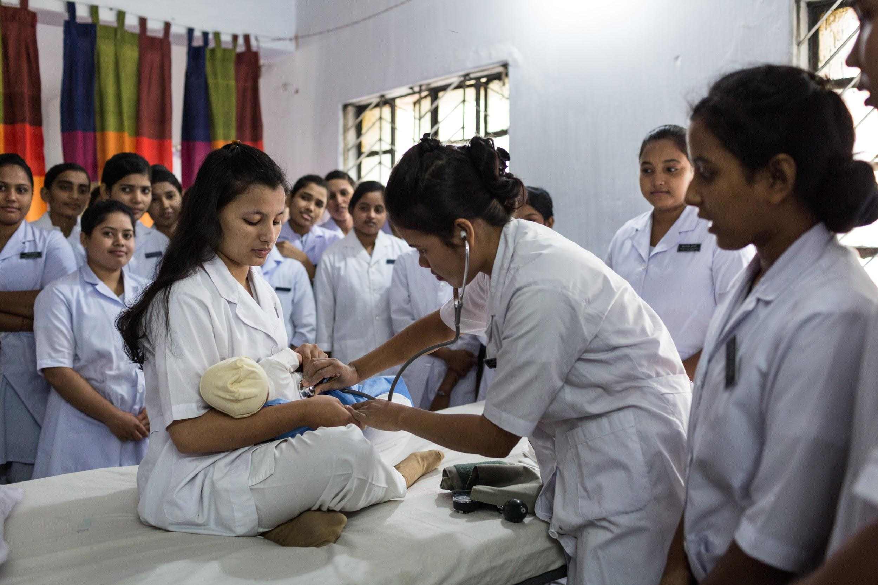
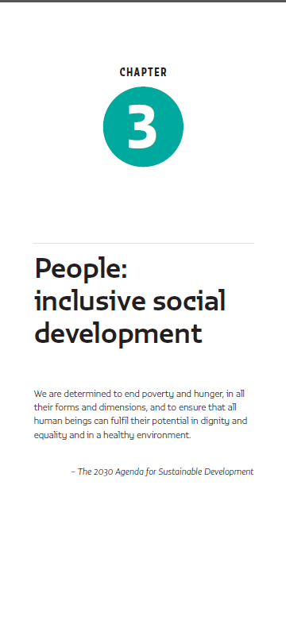
Progress in health, nutrition and gender equality is inextricably linked with progress in education
Credit: Nicolas Axelrod / Ruom for UNFPA
Notes:
Inclusive social development requires universal provision of critical services such as education, health, water, sanitation, energy, housing and transport.
Yet, in low income countries, only 28% had access to sanitation facilities, 25% had access to electricity and 67% made it to the last grade of primary education.
Inclusive social development demands taking a holistic approach to address multidimensional poverty challenges.

Slide 24
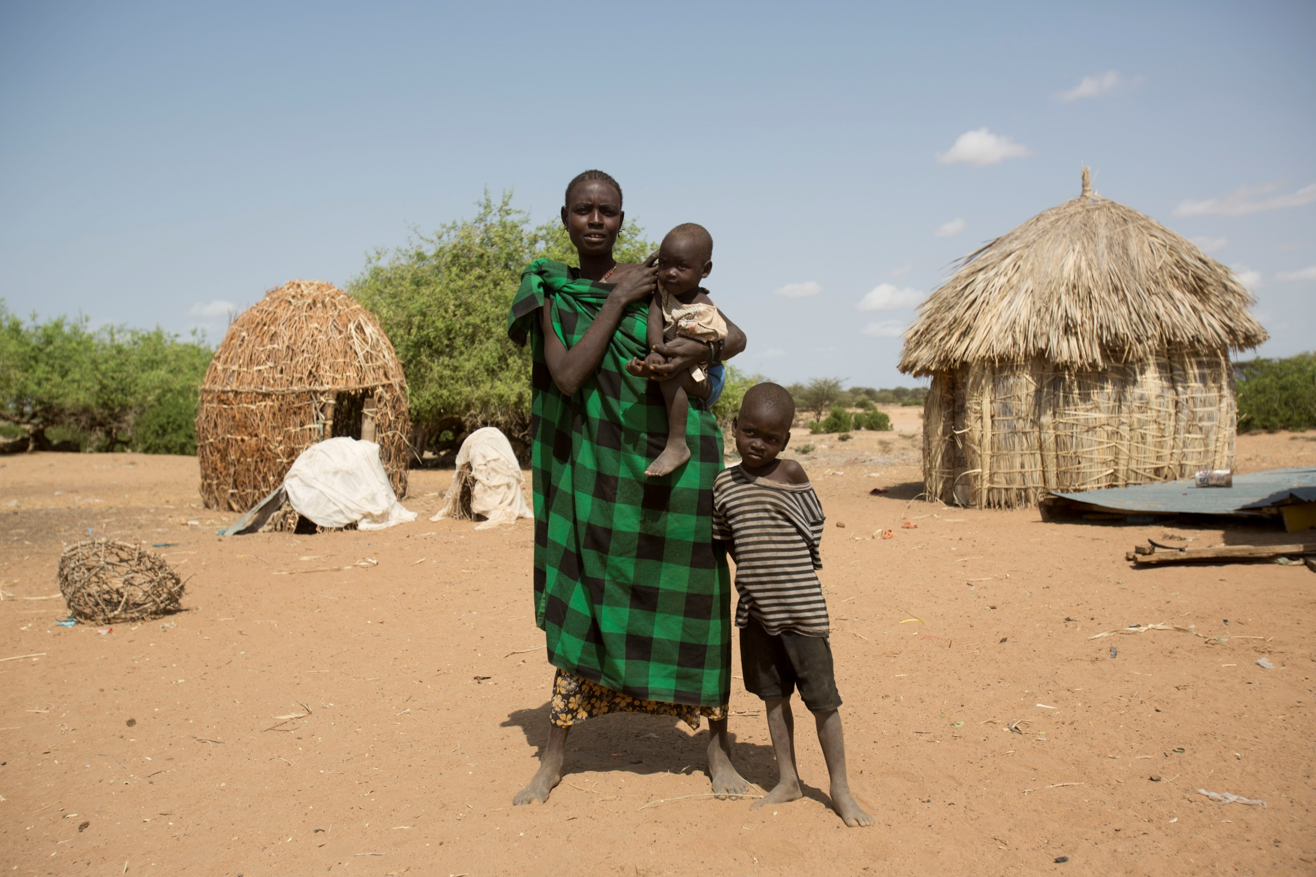
PEOPLE
Educating women is at the heart of social development
Credit: Fernanda Pineda, USAid
If women in sub-Saharan Africa achieved universal upper secondary education by 2030, it would prevent 3.5 million child deaths in 2050-60
Notes:
Educating women is at the heart of social development. More educated mothers are more likely to seek help during pregnancy and childbirth and are better able to feed their children well and keep them in good health.
Our projections show that if women achieved universal upper secondary education by 2030 in sub-Saharan Africa, it would prevent 3.5 million child deaths in the decade beginning in 2050.
Outside of health benefits, education also broadens women’s employment opportunities, which is crucial in the face of wide gender inequalities in pay, promotion and in work.
Studies from very different countries and contexts have also shown how education increases women’s political empowerment. This should be a major global priority. In 2014, only 22% of national assemblies were made up of women.

Slide 25
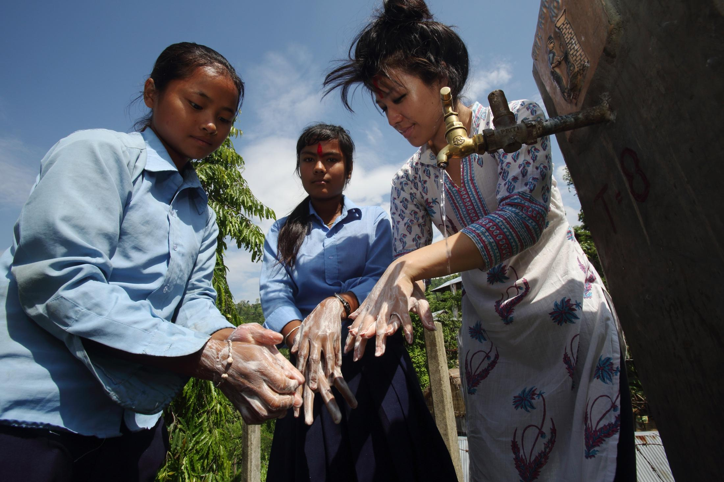
PEOPLE
Children need to be healthy and well-fed in order to attend school and learn
Credit: Eva-Lotta Jansson
Meanwhile, it costs one tenth the amount to deliver simple health interventions through teachers, than through mobile health teams
Notes:
Health and nutrition are essential for education: they condition children’s ability to attend school and learn, and their families’ ability to support them.
In Kenya, girls who received deworming treatment were 25% more likely to pass the national primary school exam.
Similarly, access to quality health care for teachers can reduce teacher absenteeism and attrition.
Meanwhile, schools have huge potential to be used to deliver health and nutrition interventions. By one estimate, it costs one tenth the amount to deliver simple health interventions through teachers, than through mobile health teams.
But education on its own is not enough to achieve equality in society and ensure all have access to the most basic of services.
We need to integrate education with actions such as social protection programmes that seek to reduce risk and vulnerability.

Slide 26
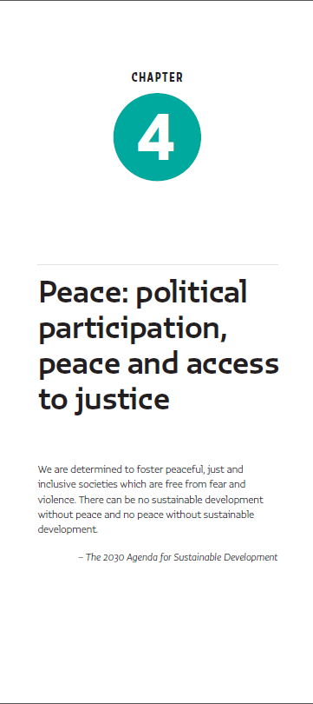
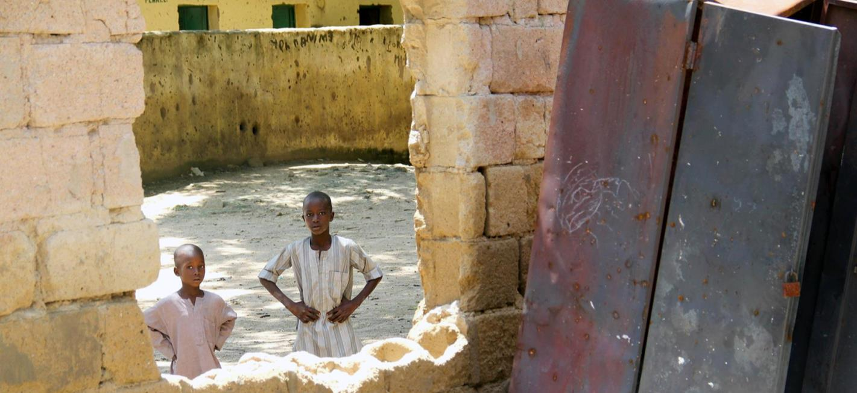
An inclusive education is a powerful preventive tool and antidote for violence
Credit: 2015 Bede Sheppard/ Human Rights Watch
Notes:
Persistent violence and armed conflict undermine personal security and well-being. Preventing violence and achieving sustainable peace require democratic and representative institutions and well-functioning justice systems. Education is a key element in expanding political participation, inclusion, advocacy and democracy.

Slide 27
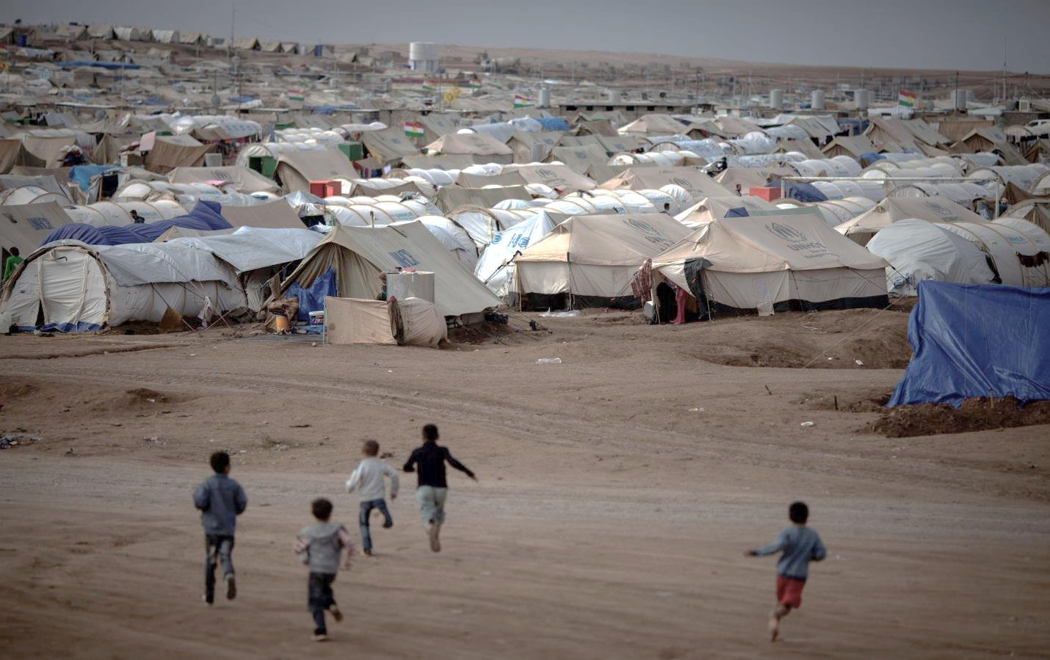
PEACE
Conflict and violence are taking a disturbingly large toll on education systems
35% of out of school children and
25% of out of school adolescents
live in conflict-affected areas
Credit: UNHCR/Brian Sokol
50% of refugee children and 75% of refugee youth are out of school
Notes:
In conflict-affected countries, 21.5 million children of primary school age and 15 million adolescents of lower secondary age are out of school, representing 36% and 25% of the total respectively.
Our latest research with UNHCR, showed that 50% of refugee children are out of primary school and 75% of refugee youth are out of secondary school. And these figures only touch on those in camps, and not those who live in urban areas, where enrolment levels are likely far worse.
Meanwhile, education is often directly under attack, with teachers and students directly impacted, and schools used for military purposes.
Other forms of violence, including school-based bullying & sexual violence are also taking their toll, not only on access to education, but also on learning outcomes.

Slide 28
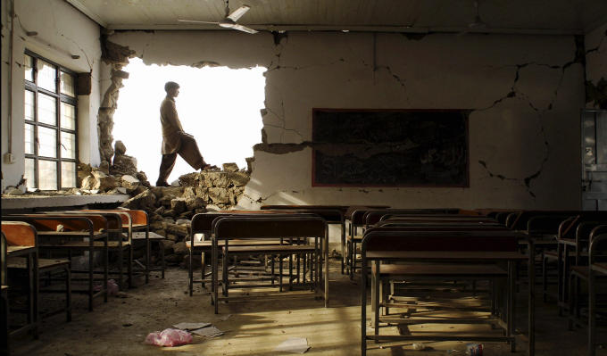
PEACE
Education can reduce violence and conflict; even more so when inclusive in access, language and content
Conflict is less likely if education enrolment levels are high and more equitable
Almost one-third of recent peace agreements do not mention education
Credit: Eyedea
Notes:
Education can be a powerful preventative tool for violence and conflict. Data from 100 countries shows that countries with wider education gaps are more likely to be in conflict.
Yet the issue has not been given proper attention in peace agreements. Of all agreements signed between 1989 and 2005, almost one third made no mention of education at all.
The content of education is crucial in laying the foundation for and maintaining peace.
Language in education policies can also be a source of wider grievances especially if they discriminate against certain population groups.

Slide 29
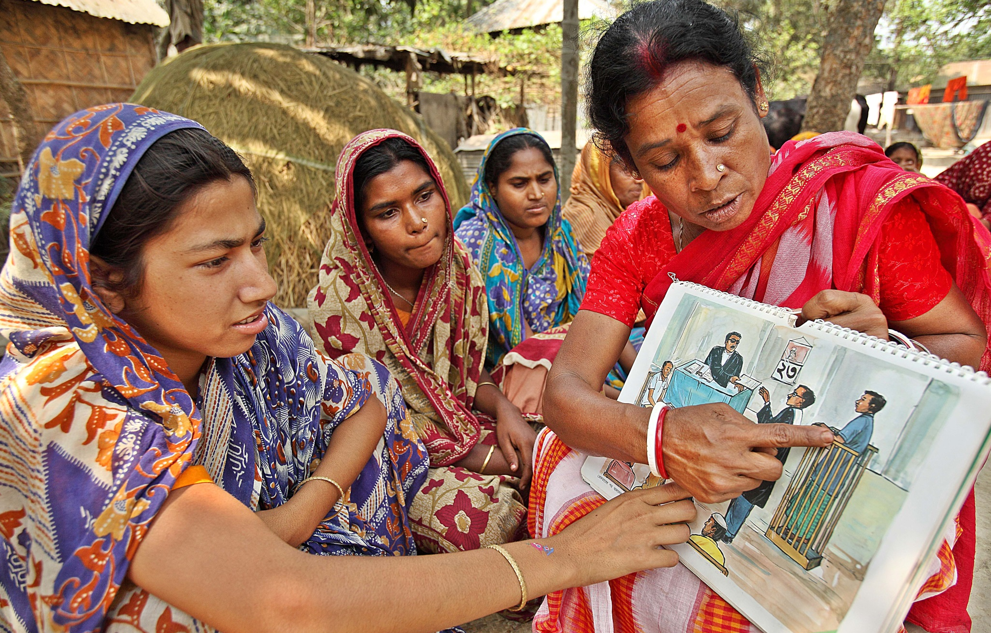
PEACE
Education can help people participate peacefully in political processes and justice systems
Credit: BRAC Bangladesh
Those with higher education are more likely to channel discontent through non-violent protests
Notes:
Education can also lead to more constructive political processes, and more peaceful protests by helping people participate in politics and access political information.
Open and collaborative teaching, and well-designed civics education have been shown to lead to greater participation in politics
Likewise, equitable and quality education can give people the literacy and related skills to access political information, for example ensuring they understand the language that political campaigns are using.
Across 102 countries, adults with a tertiary education were 60% more likely to request information from the government than those with a primary education or less.
Voter education programmes can help inform about the mechanisms of voting and reduce electoral misconduct, particularly if targeted at marginalised members of the community.
A functioning justice system is critical for sustaining peaceful societies. However, many citizens lack the skills to gain access to complex justice systems, which community based education programmes can help address. In 2011, in the Former Yugoslav Republic of Macedonia, tertiary education significantly increased the extent to which people were well or partially informed about the judicial system and its reforms.
Building the capacity of judicial and law enforcement officers is critical. Otherwise, there may be flawed or insufficient evidence-gathering, lack of enforcement, and abuse. In Haiti, the national police went from being the least to the most trusted public institution over five years through a seven month training programme.

Slide 30
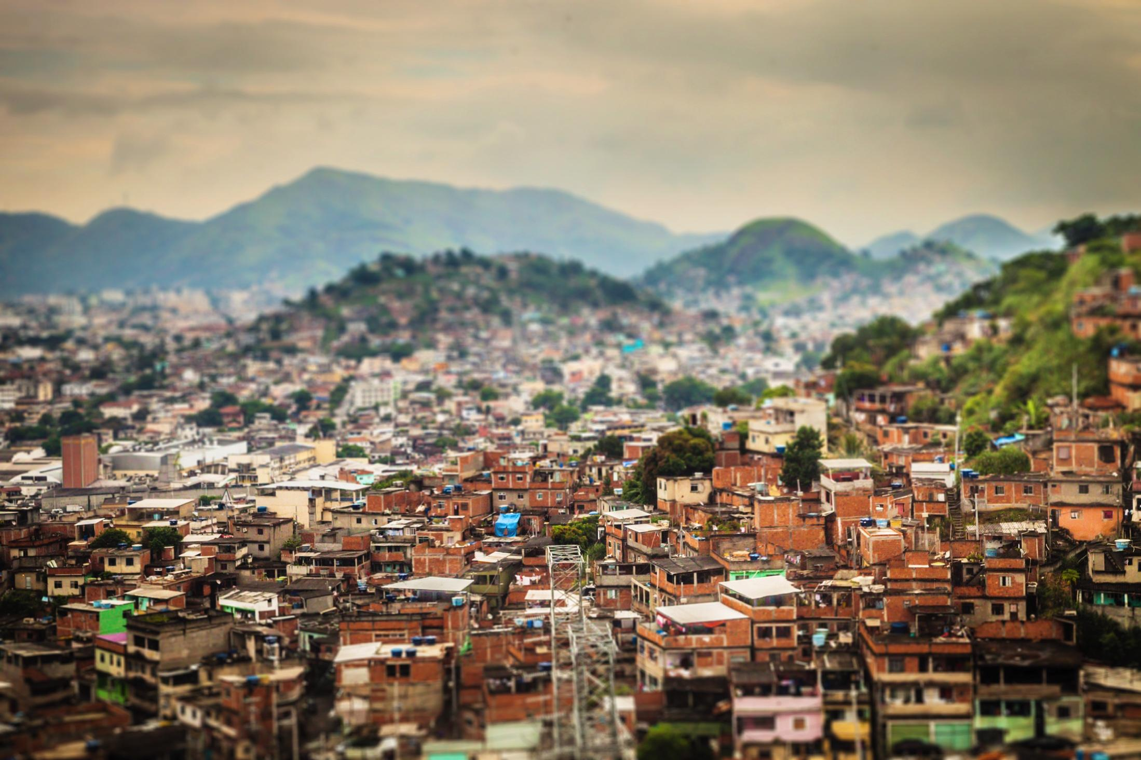
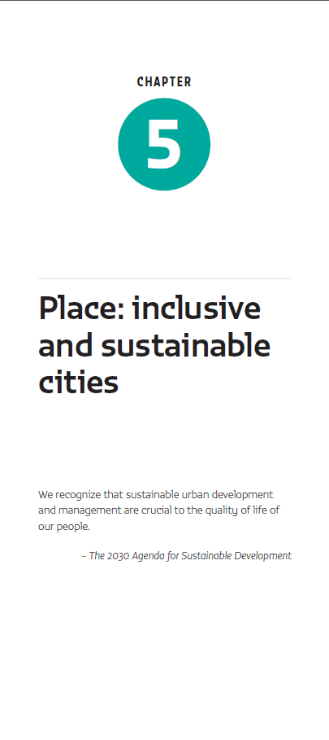
Education must be integrated into urban planning to create sustainable cities
Credit: Anna Spysz
Notes:
Urbanization is one of today’s defining demographic trends – over half of the world lives in cities and urban areas. In the coming decades most projected urban population growth will occur in cities in low income countries.
Currently, the education sector is largely missing from key urban planning and development discussions. The report shows why education should be integrated into urban planning so that the education needs and rights of all are met as urban populations change.

Slide 31
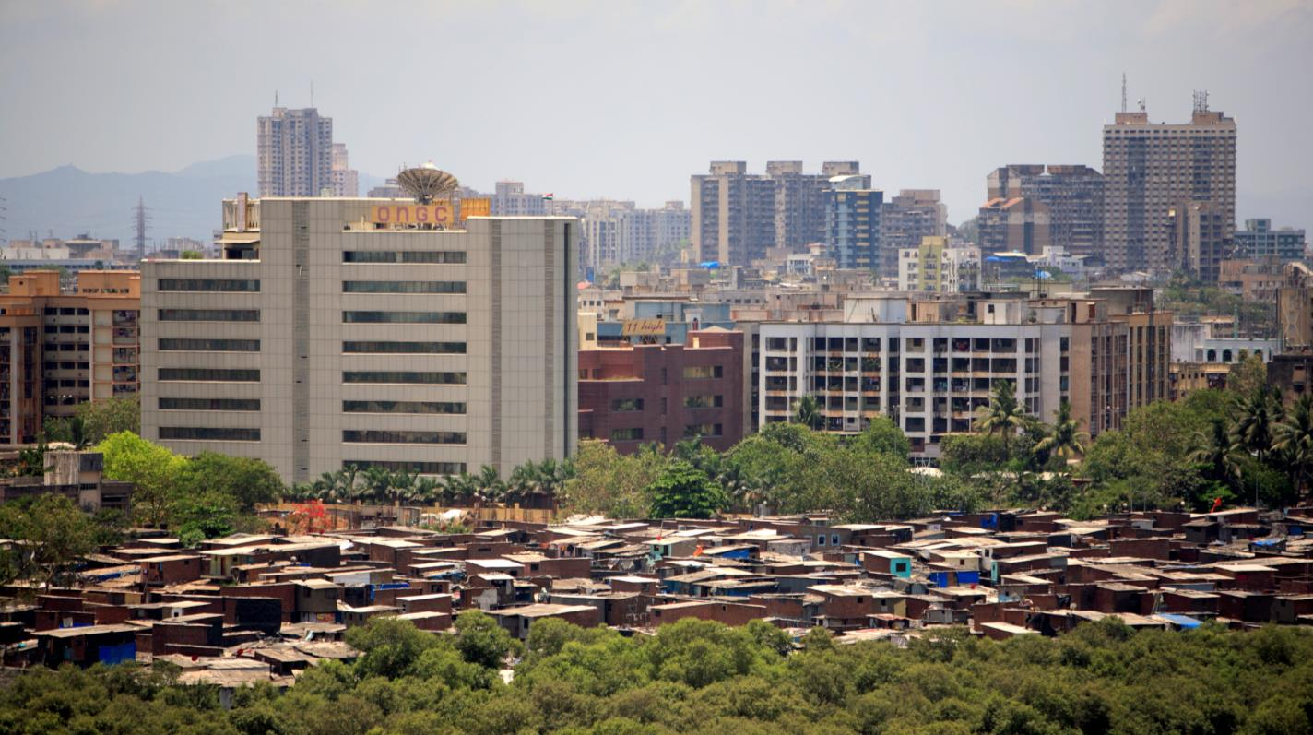
PLACES
Fast urban growth is putting strain on education systems
More than one-third of urban residents in lower income countries live in slums or shanty towns
Credit: Kate Holt
6 in 10 refugees live in urban areas
Notes:
Fast urbanisation is putting a strain on education systems.
More than one-third of urban residents in lower income countries live in slums or shanty towns in city centres or urban peripheries. Many slums are characterized by poor access to basic services, including education, and especially to education that is publicly provided.
By late 2014, 6 out of 10 refugees lived in urban areas. In Turkey, only 30% of refugees in urban areas are enrolled in school.
Meanwhile, migrants to cities looking for employment face challenges such as discrimination, language barriers, unemployment and exploitation in the informal economy.
In China, which experienced the largest rural-urban migration in human history, access to public schools was restricted for children of migrants. The government then reversed this situation by abolishing fees for rural migrant children and providing extra funding to schools.

Slide 32
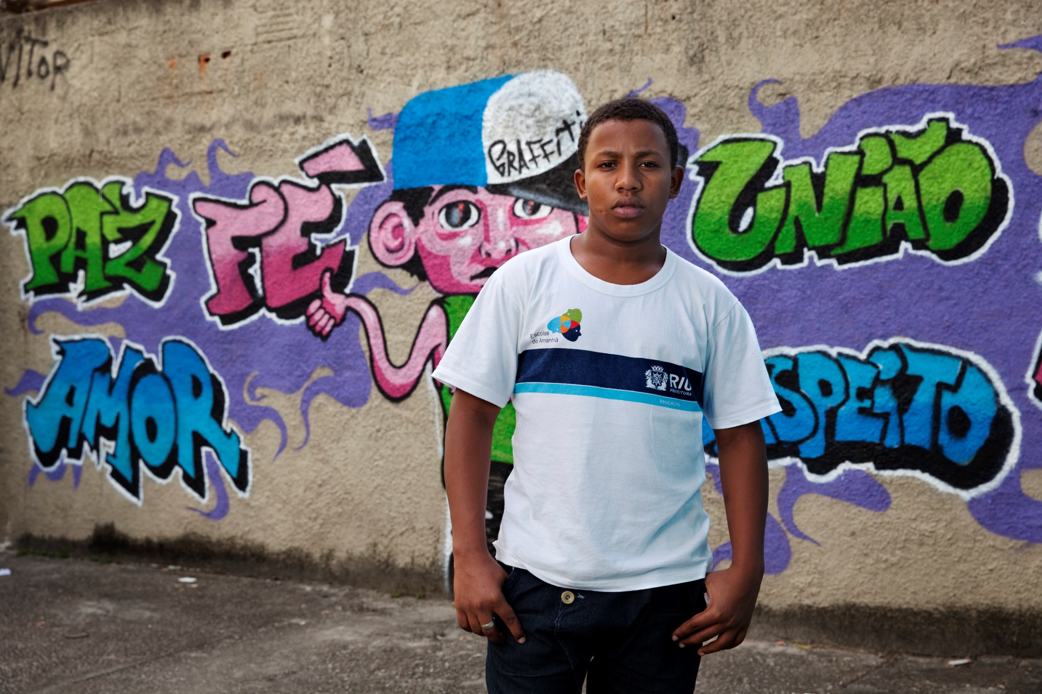
PLACES
Addressing inequalities in education can address urban problems, like unemployment and crime
Teacher training can also reduce discriminatory attitudes that exacerbate social marginalisation
Credit: Eduardo Martino
Notes:
Inviting education planners to the table in discussions around urban policies would help address unequal access to quality public schools, and the uneven distribution of quality teachers by area.
Teacher preparation and mentoring programmes can reduce discriminatory attitudes that exacerbate social marginalization and exclusion throughout cities.
Education also has a positive social impact, particularly in reducing crime, as shown in the Report with examples from the United Kingdom, the United States, South Africa and Italy.

Slide 33
PLACES
Urban planning that considers education can transform cities
Credit: Craig Stanfill
Education propels cities’ competitiveness and can make them more environmentally friendly
Notes:
Cities can attract human capital and foreign direct investment by positioning themselves as global hubs for higher education, skills, talent, knowledge and innovation.
The megacity of Shanghai, China, attracts a wide range of talent, has access to over 100,000 graduates and has doubled the proportion of college-educated labour force in a decade. Stanford University has reportedly had significant global economic impact: 18,000 firms created by its alumni are based in urban areas in its home state of California.
Education can also help cities to become green. Curitiba and Medellin are both cities that have used education initiatives to become among the greenest cities in the world. Many cities are expanding cycling programmes as a form of green transportation; in Denmark schools encourage cycling and teach children from a young age safe cycling habits.

Slide 34
We must pull together if we are to achieve the 2030 Agenda for Sustainable Development
Credit: Marisol Grandon/Department for International Development
Notes:
The GEM Report pays special attention to the importance of developing integrated approaches to solve complex, collective problems.
However, the notion of integrated planning still exists mostly on paper as its potential benefits are not fully realized.
Few countries have genuinely pushed for integrated actions and budgets. Without strong political incentives and adequate financial backing, planning and implementation in most contexts will not change their ways of working.

Slide 35
PARTNERSHIPS
More domestic resources are needed if we are to achieve our goals
Education can increase tax compliance
Notes:
One key barrier standing in the way of progress is the persistent finance gap for all our development goals, including for education.
At least 35 countries – from different parts of the world - spend less than both minimum thresholds proposed in the Incheon Declaration, namely 4% of GDP and 15% of total public expenditure.
Mobilizing more domestic resources will be critical.
In some cases, this can be done by increasing the priority given education. In others, policies to raise tax revenue are needed. In about half of all lower income countries, tax ratios are below 15% of GDP, compared with 26% in advanced economies. Education can improve taxpayer behaviour and increase compliance. In 123 countries, low literacy rates were associated with reduced tax revenues.

Slide 36
PARTNERSHIPS
Aid to education is declining and not effectively targeting those most in need
Since 2003 aid to education in 170 countries has been associated with donor trade-related interests, and not numbers in school
Notes:
In addition, aid is not being allocated to those facing the biggest education challenges. Rather it is frequently associated with donor trade-related interests. To reach our goals, aid must be better aligned to helping those most in need.
The graph on this slide illustrates the gap between aid to education and actual need. For example, Chad only received US$3 per child in 2014, even though only 28% were completing primary school. Mongolia, by contrast, received $45 per child even though almost 100% are completing. Liberia and Mauritania, in red, have roughly the same completion rates but receive vastly different amounts of aid to education.

Slide 37
FINAL RECOMMENDATIONS
For education to be transformative in support of the new sustainable development agenda, ‘education as usual’ will not suffice
1. Collaborate across sectors
2. Governments need to view formal and non-formal education and training as key to their efforts to tackle cross-sector problems
3. Education Ministries and Ministries of Labour should work together to reduce income inequality.
6. Change the focus of education:
a) In developing skills policies, consider both medium- and long-term needs and the implications of sustainable growth
b) Civic, peace and sustainability education programmes can be important levers for SDG progress
4. Education systems need increased and predictable financing
5. Improve equity
Notes:
These policy recommendations suggest how education systems can contribute more effectively to sustainable development.
Support collaborations and synergies across all sectors and partners. Since systemic problems require multiple actors and diverse perspectives, stronger efforts are needed to involve all partners, including ministries, education experts, and civil society, at the local and national level, and across sectors.
Governments need to view formal and non-formal education and training as key to their efforts to tackle cross-sector problems. Education and lifelong learning can help build capacity in all sectors. Many SDG targets require specialized skills and expertise that education systems provide.
Education can help reduce income inequality, but not on its own. Expanding access by marginalized groups to good quality primary and secondary education will help ensure decent incomes and reduced disparity. Changes to labour market regulations and technology should not penalize workers in less secure jobs, especially in the informal sector.
Education systems need increased and predictable financing to (a) universalize completion of primary and secondary education; (b) increase numbers of qualified, knowledgeable and motivated teachers; (c) provide good quality education to marginalized populations; and (d) prepare for the impact of climate change, natural disasters and the possibility of protracted conflict.
Among many benefits of improving equity in education, universal primary and secondary education, especially for girls, would curtail population growth, transform social norms and practices across generations, and limit the burden on the planet.
Last, we need to revisit the purposes of education: what learning is needed to achieve the ambitious 2030 Agenda.
In developing skills policies, education systems should address both medium- and long-term needs and the implications of sustainable growth. Teaching green skills to students and providing workers with opportunities to retrain and improve their skills are needed, as are changes in secondary and tertiary level curricula. Better cooperation with business and industry would improve relevance and quality of teaching and learning.
Civic, peace and sustainability education programmes can be important levers for SDG progress. Effectively implemented, they can ensure a more equitable justice system, build capacity in judicial and law enforcement, foster less violent and more constructive societies, increase understanding of the links between culture, economy and environment, and prioritize actions that improve the lot of future generations.

Slide 38
Download the Report:
Bitly.com/sdg4all
Blogs:
gemreportunesco.wordpress.com
educacionmundialblog.wordpress.com
#SDG4All
@GEMreport
Notes:
We have come to the end of the presentation.
Thank you for listening. The findings and recommendation in this report speak to so many different audiences and sectors, and we will need all your support in helping us disseminate them widely.
Please do join in the conversation and find out more via our website, or on twitter with the hashtag #sdg4all.

